Slide 1

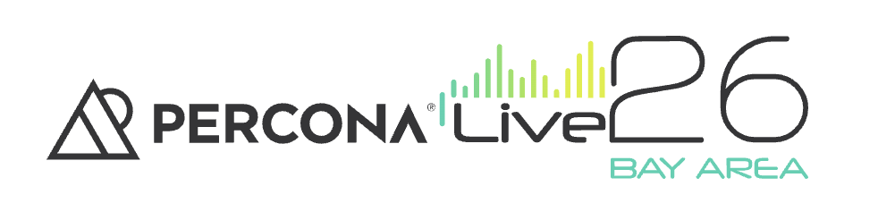
Why Your Database Fails in AWS (And It’s Not the Database’s Fault)
Thursday, May 28 - 11:20 – 11:50 Learning Lab
Jhonis de Souza
Adamo Tonete

Slide 2

About
Jhonis de Souza - DevOps Engineer - Trilogy
Former Software Engineer, on DevOps side of the force for +5 years
AWS Expert | Long-Life Learner
What I have been working on recently:
Keeping cloud costs low and blood pressure high
Converting outages into conference talks

Slide 3
About
Adamo Tonete - MongoDB SME - Amach - @adamotonete
Been in this field for about 15 years
than 10 years working with MongoDB Database
Brazilian

Slide 4

Agenda
Case 1:
Hidden Infrastructure Bottlenecks
Case 2:
Application Behavior Amplifying Database Failures
The Bigger Pattern
Failures Propagate Across Systems
Modern Observability for Database Platforms

Slide 5
Case 1
At 1AM, a healthy-looking database suddenly became one of the biggest production incidents of the week.

Slide 6
Case 1 - The Incident
1:07 AM and Customer Support reports slowness in the application
APIs timing out
Pages taking several seconds to load
No deployment happened
No traffic spike detected
Monitoring didn't show anything different than the usual

Slide 7
Case 1 - Initial Investigation
DB CPU | ✅ Normal
DB Memory | ✅ Normal
Slow Queries | ✅ Unchanged
Replication Lag | ✅ Healthy
Users | 🤯 Angry
What is the problem then? 🤔

Slide 8
Case 1 - Environment Context
Cloud Service | AWS RDS MySQL
Instance Type | db.m8g.2xlarge
Volume Type | gp2
Volume Size | 200GB
IOPS Baseline | 600 IOPS

Slide 9
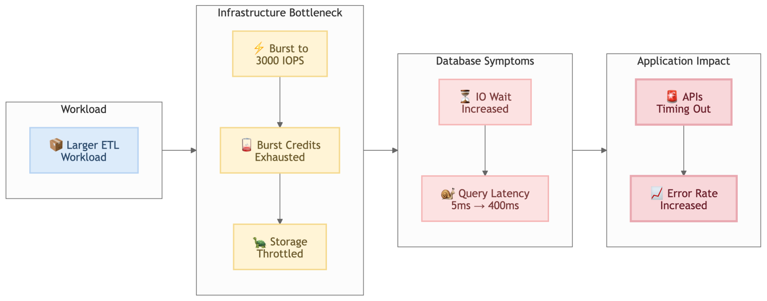
Case 1 - What actually happened

Slide 10
The database wasn’t slow.
The storage layer was, and monitoring was missing metrics

Slide 11
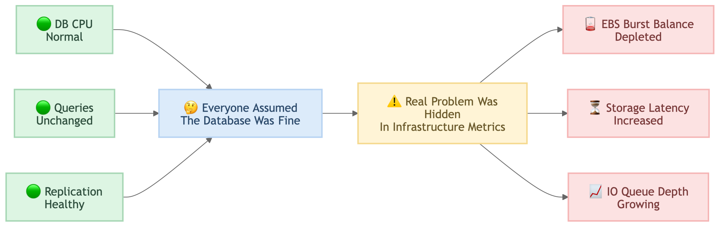
Case 1 - Why we missed it?

Slide 12
Case 1 - Lessons Learned
What have we changed after the incident:
❌ Before the incident ✅ After the incident
gp2 default configuration Provisioned gp3 IOPS
DB metrics only Correlated DB + EBS metrics
No ETL load testing Synthetic workload validation
Reactive troubleshooting Proactive capacity planning

Slide 13
Case 2
The database looked guilty from the very beginning.

Slide 14
Case 2 - The Incident
Our monitors reported intermittent downtime on the applications.
First look in the metrics showed:
Applications timing out
Connection pools exhausted
Database CPU at 99%
Lock contention everywhere
A classic database outage 😎

Slide 15
Case 2 - Environment Context
Platform
Multi-tenant RDS Aurora cluster
Multiple customer-facing applications
Shared authentication and profile services
Symptoms
APIs intermittently unavailable
Connection exhaustion
High IO wait
Massive DB CPU spike

Slide 16
Everyone blamed the database.

Slide 17
Case 2 - Investigation
No deployment changes
No expensive new queries
No schema changes
Query patterns looked familiar

Slide 18
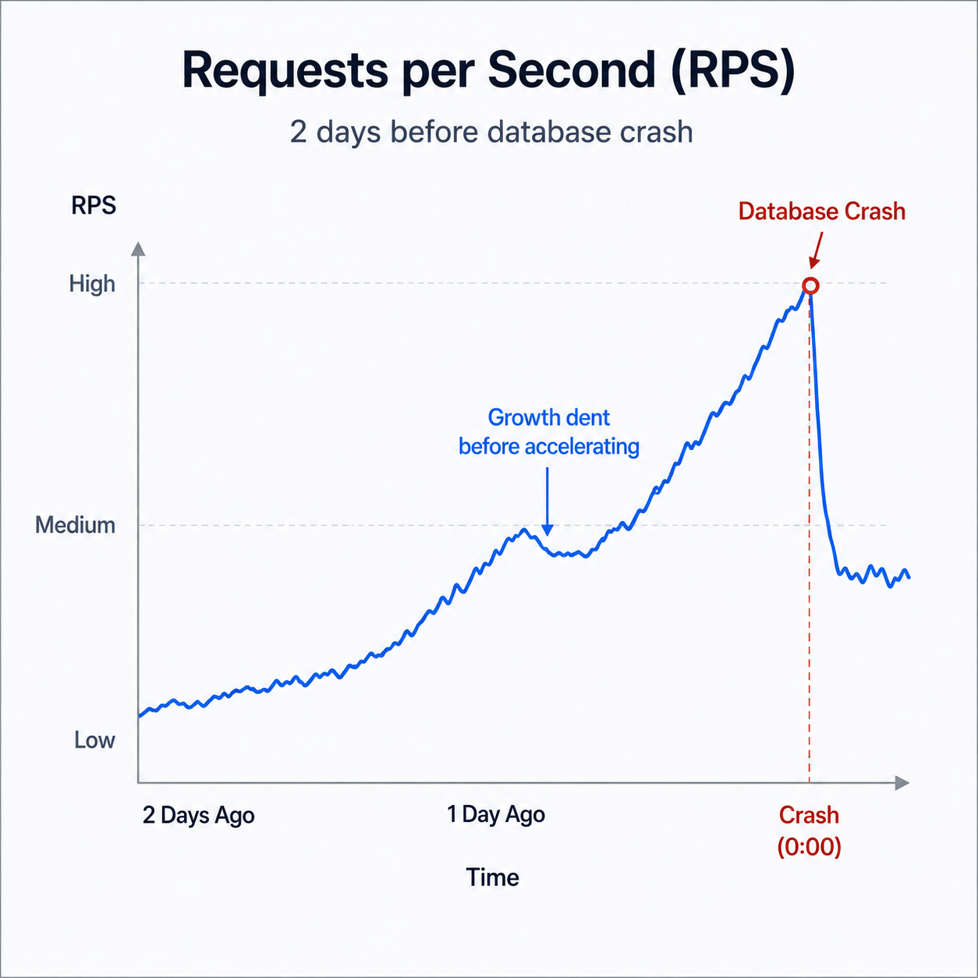
Case 2 - The Pivot
The database was overloaded because the application was flooding it 🤦‍♂️
Traffic pattern 2 days before:
~5k requests/minute
Incident traffic:
~60k repeated requests/minute

Slide 19
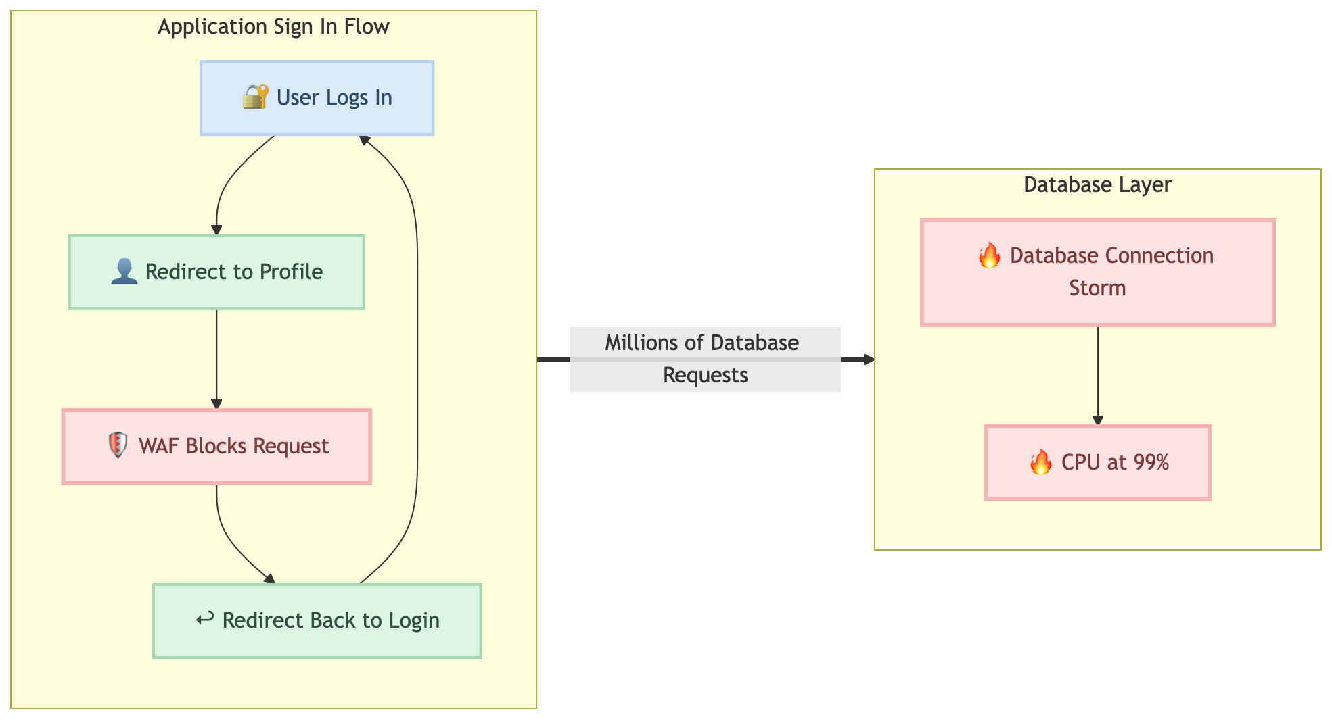
Case 2 - The Big Reveal

Slide 20
The database was the victim.

Slide 21
Case 2 - Lessons Learned
What have we changed after the incident:
❌ Before the incident ✅ After the incident
Direct WAF rollout Canary WAF deployment
Retry-heavy behavior Backoff/circuit breakers
DB-only monitoring Correlated app + WAF + DB telemetry
Reactive debugging Request anomaly detection

Slide 22
Two different incidents. One recurring pattern.
Case 1 → Infrastructure bottleneck
Case 2 → Application request amplification
Same result:
The database appeared guilty.

Slide 23
We were monitoring components.
Not systems.

Slide 24
What Modern Observability Needs to Monitor
Database Layer
Query Latency
Replication Lag
Connection Retention
Application Layer
Retry Storms
Request Amplification
Pool Exhaustion
Infrastructure Layer
EBS Latency
IO Queue Depth
Network Throughput
Saturation Indicators

Slide 25
What To Bring Back To Your Team
✅ Correlate DB + infra + application telemetry
✅ Monitor saturation, not only utilization
✅ Track end-to-end latency
✅ Treat retries as failure amplifiers
✅ Validate systems under stress
✅ Reactive -> Proactive monitoring (PMM)

Slide 26
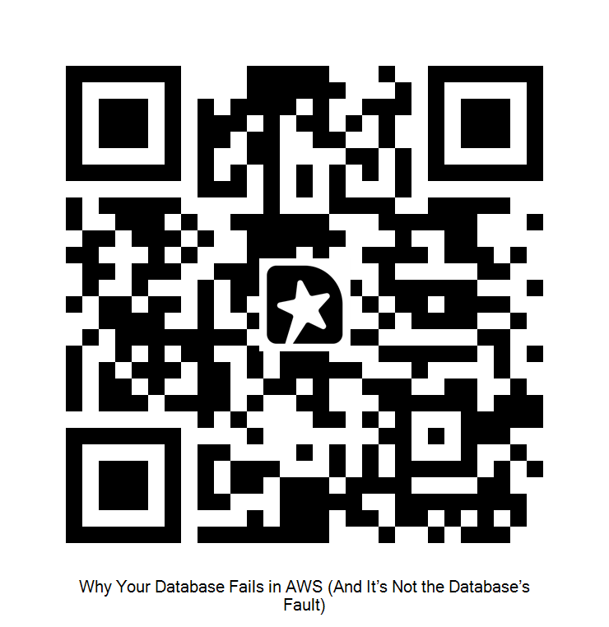

Questions?
Let's connect on LinkedIn
https://www.linkedin.com/in/jhonissouza/
Use the QR code above for feedback

