Slide 1

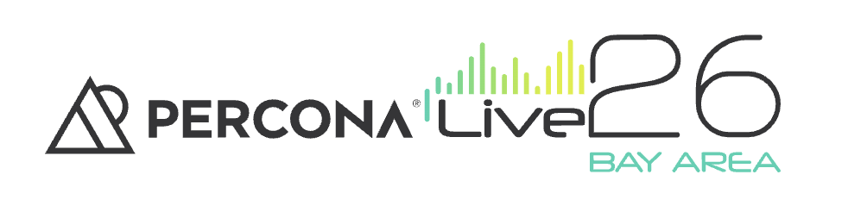
TLS for Self-Managed MongoDB: Let’s Encrypt, mTLS, and the Future of Public Certs
Wednesday, May 27 - 11:20 – 11:50 Boole
Adamo Tonete
Jhonis de Souza

Slide 2
Agenda
The TLS Gap Between Atlas and Self-Managed Deployments
Encryption, integrity, authentication; TLS vs mTLS
Security and Performance Improvements in TLS 1.3
MongoDB TLS in practice: client vs intra-cluster encryption
2026 CA Changes: End of Public Client Authentication Support
Automated TLS Architecture with Let’s Encrypt on AWS

Slide 3
About
Adamo Tonete - MongoDB SME - Amach - @adamotonete
Working in the database field for over 15 years
More than 10 years working with MongoDB
Jhonis de Souza - DevOps Engineer - Trilogy
Former Software Engineer, on DevOps side of the force for +5 years
AWS Expert | Continuous Improvement Focused

Slide 4

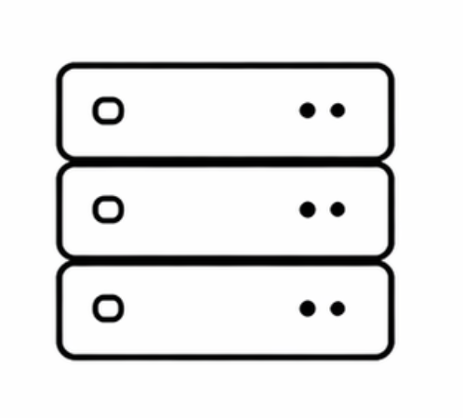
The TLS Gap Between Atlas and Self-Managed Deployments
MongoDB Atlas: TLS enabled by default
Self-managed: manual configuration required
Risks:
  Misconfiguration
  Expired certificates
  Operational overhead
Notes:
mention that for some companies not habing TLS in place is ok, but it is very unlikely

Slide 5



TLS Fundamentals
Encryption: protects data in transit
Integrity: prevents tampering
Authentication: verifies identity (hostname)
X509 - client ownership of the certificate

Slide 6
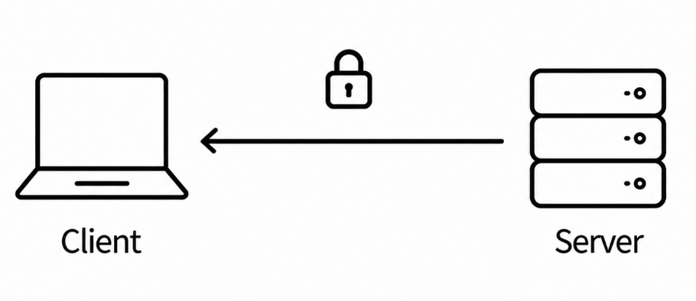
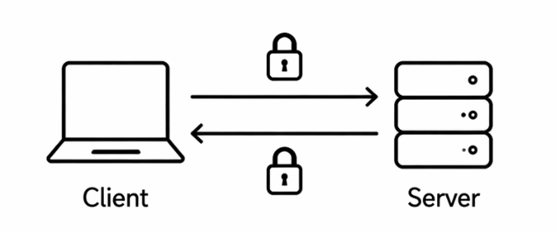
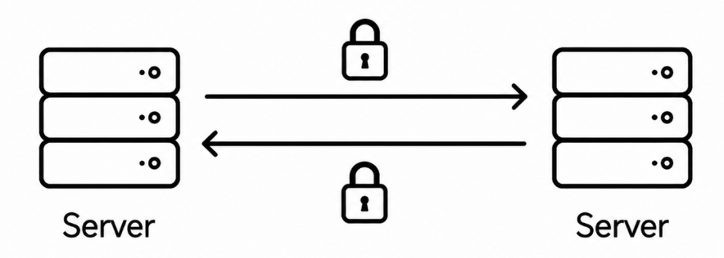
TLS vs mTLS
TLS (standard):
Only server is authenticated
mTLS (mutual TLS):
Both client and server authentication
MongoDB usage:
TLS: client connections
mTLS: intra-cluster communication

Slide 7
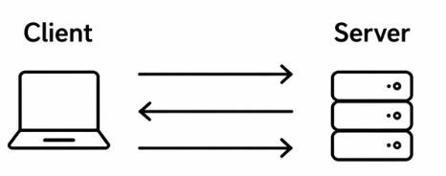
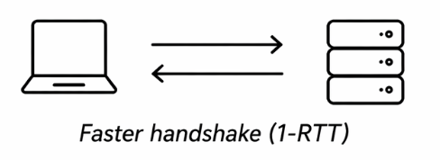
TLS 1.2 vs TLS 1.3
TLS ≤ 1.2:
  More round trips
  Legacy ciphers supported
  Perfect Forward Secrecy optional
TLS 1.3:
  Faster handshake (1-RTT)
  Only modern ciphers
  Forward secrecy by default

Slide 8
Why TLS 1.3 Matters for MongoDB
Lower connection overhead
Better performance at scale
Aligns with modern platforms and OpenSSL 3
Essential for future-proof deployments

Slide 9
MongoDB TLS in Practice
Two TLS Communication Paths
Client -> MongoDB
  Client as user/app
Node - > Node (replica set / shards)
Key configs:
net.tls:*
https://www.mongodb.com/docs/manual/reference/configuration-options/#net.tls-options

Slide 10
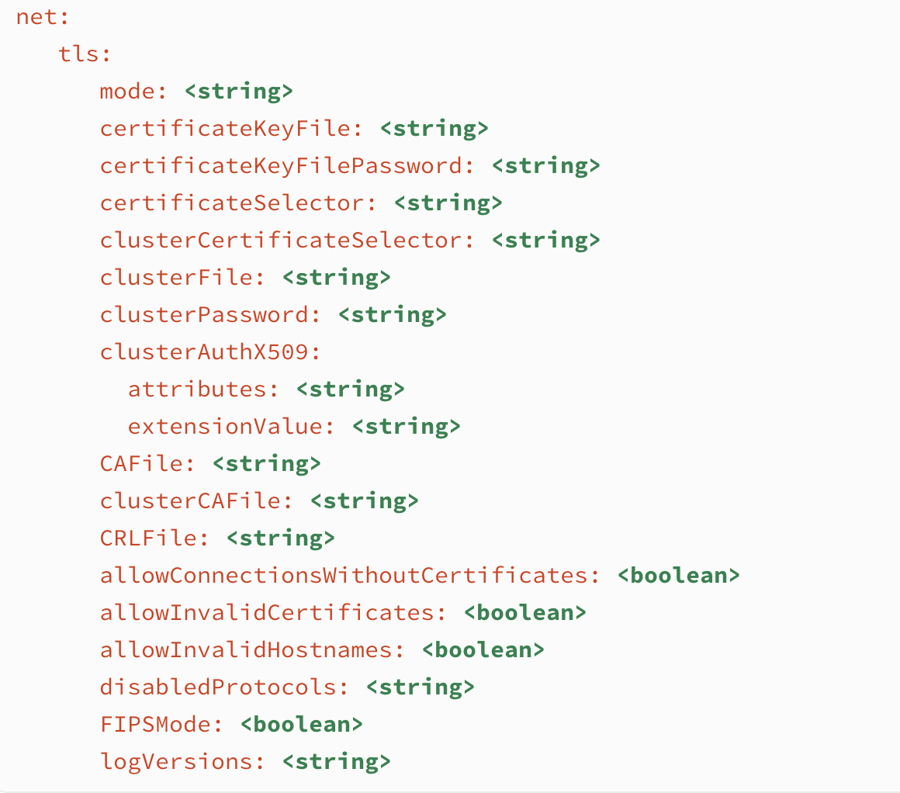
MongoDB TLS in Practice

Slide 11
Common Challenges - Self Managed
Certificate creation and distribution
Renewal management
Downtime risk on expiration
Complexity in scaling environments

Slide 12
Private CA - Self Managed
EJBCA
HashiCorp Vault PKI Secret Engine:
openssl

Slide 13
2026 Public CA Changes
What is changing:
Public Certificate Authorities will stop issuing certificates for client authentication purposes
Why:
Security and abuse concerns
Public CAs are shifting toward server-only authentication models
Impact:
Certificates from public CAs will no longer work for mTLS (client auth)
Breaks current setups using the same certs for:
Client connections and Intra-cluster authentication
https://letsencrypt.org/2025/05/14/ending-tls-client-authentication

Slide 14
Public CA's
Let's Encrypt
DigiCert
GlobalSign
GoDaddy

Slide 15
Impact on MongoDB
mTLS deployments relying on public certificates will break
Affects:
  Replica sets
  Sharded clusters

Slide 16
MongoDB Settings
tls:
certificateKeyFile: /opt/mongo02.pem
mode: requireTLS
allowConnectionsWithoutCertificates : true # allows conn without cert
security:
keyFile: /opt/keyfile

Slide 17
Invalid Cert EKU
{"t":{"$date":"2026-05-13T17:23:06.780+00:00"},"s":"E", "c":"NETWORK", "id":23256, "ctx":"conn786","msg":"SSL peer certificate validation failed","attr":{"error":"SSL peer certificate validation failed: unsuitable certificate purpose"}}
{"t":{"$date":"2026-05-13T17:23:06.780+00:00"},"s":"I", "c":"EXECUTOR", "id":22988, "ctx":"conn786","msg":"Error receiving request from client. Ending connection from remote","attr":{"error":{"code":141,"codeName":"SSLHandshakeFailed","errmsg":"SSL peer certificate validation failed: unsuitable certificate purpose"},"remote":"172.31.29.18:47038","connectionId":786}}

Slide 18
Solution for Public Certificate
setParameter:
tlsWithholdClientCertificate : true
# This forces the node to avoid sending its own certificate during outbound connections

Slide 19
MongoDB Settings
tlsWithholdClientCertificate
Available for both mongod and mongos.
Default: false
A TLS certificate is set for a mongod or mongos either by the --tlsClusterFile option or by the --tlsCertificateKeyFile option when --tlsClusterFile is not set. If the TLS certificate is set, by default, the instance sends the certificate when initiating intra-cluster communications with other mongod or mongos instances in the deployment. Set tlsWithholdClientCertificate to 1 or true to direct the instance to withhold sending its TLS certificate during these communications. Use this option with --tlsAllowConnectionsWithoutCertificates (to allow inbound connections without certificates) on all members of the deployment. tlsWithholdClientCertificate is mutually exclusive with --clusterAuthMode x509.
This parameter is only available at startup. To set the parameter, use the setParameter setting.

Slide 20
MongoDB Settings
net.tls.clusterFile
Type: string
The .pem file that contains the X.509 certificate-key file for membership authentication for the cluster or replica set.
On macOS or Windows, you can use the net.tls.clusterCertificateSelector option to specify a certificate from the operating system's secure certificate store instead of a PEM key file. net.tls.clusterFile and net.tls.clusterCertificateSelector options are mutually exclusive. You can only specify one.
If net.tls.clusterFile does not specify the .pem file for internal cluster authentication or the alternative net.tls.clusterCertificateSelector, the cluster uses the .pem file specified in the certificateKeyFile setting or the certificate returned by the net.tls.certificateSelector.

Slide 21
Checking certificate content
openssl x509 -in cert.pem -text -noout
openssl x509 -in cert.pem -text -noout -ext extendedKeyUsage

Slide 22
No Certificate Provided Error
tls:
certificateKeyFile: /opt/mongo.pem
mode: requireTLS
allowConnectionsWithoutCertificates : false #default certificateKeyFile
security:
authorization: enabled
keyFile: /opt/keyfile

Slide 23
Client without certificate error
{"t":{"$date":"2026-05-13T17:33:52.441+00:00"},"s":"I", "c":"NETWORK", "id":6723804, "ctx":"conn7951","msg":"Ingress TLS handshake complete","attr":{"durationMillis":4}}
{"t":{"$date":"2026-05-13T17:33:52.441+00:00"},"s":"E", "c":"NETWORK", "id":23255, "ctx":"conn7951","msg":"No SSL certificate provided by peer; connection rejected"}
{"t":{"$date":"2026-05-13T17:33:52.568+00:00"},"s":"I", "c":"NETWORK", "id":6723804, "ctx":"conn7953","msg":"Ingress TLS handshake complete","attr":{"durationMillis":5}}

Slide 24
Automatable TLS with Let’s Encrypt
Free public certificates
Automated issuance and renewal
Eliminates most manual certificate lifecycle management
Github: https://github.com/adamotonete/mongodb-certbot

Slide 25
Sample Architecture Overview
EC2 → MongoDB nodes
Route53 → DNS + validation
Let’s Encrypt → certificate authority
Terraform → automation

Slide 26
Automation Flow
Deploy infrastructure
DNS validation via Route53
Certificate issuance
Install on MongoDB nodes
Automatic periodic renewal

Slide 27
Benefits
No certificate expiration issues
Reduced operational overhead
Secure-by-default approach
Atlas-like experience

Slide 28
Key Takeaways
TLS is mandatory for modern deployments
TLS 1.3 improves both security and performance
Public CA changes significantly impact mTLS-based intra-cluster communication
Private CAs remain a viable solution for mTLS deployments
Automated certificate rotation is essential for production environments

Slide 29
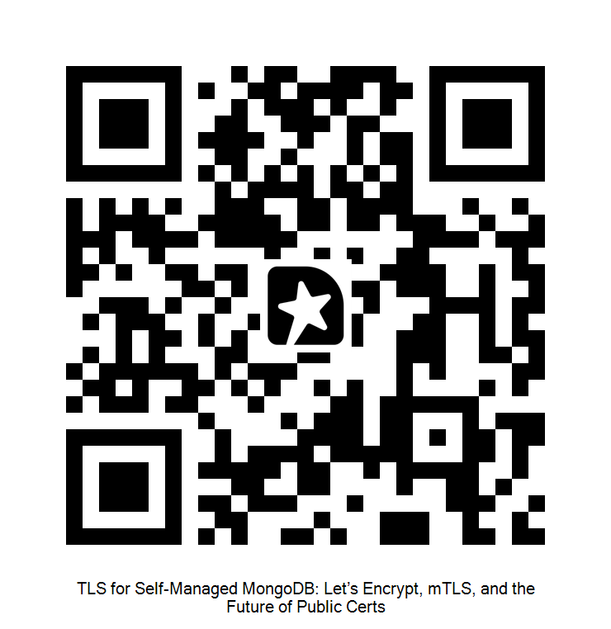
Questions & Feedback

