Slide 1
The Importance of Realistic Benchmarks
Percona Load Generator for MongoDB
Daniel Almeida - Senior Consultant

Slide 2
Oh no, another benchmarking tool?

Slide 3
Realistic Benchmarking & Workload Simulation
Models how applications actually interact with MongoDB
Workloads with mixed operations and concurrency
Control query patterns and execution behavior
Performance testing, validation, and troubleshooting

Slide 4
Benchmark the workload, not the database in isolation

Slide 5
Test What Your Application Actually Does
Benchmarks should reflect your application’s specific workloads
Customizable – Supports custom query patterns, mixed operations, concurrency and more
Enables performance testing, capacity planning, and issue reproduction

Slide 6
Performance Is Not Fixed
Database performance is workload dependent
The same cluster can look good or bad depending on query patterns and application design
Realistic tests expose design limits before customers do

Slide 7
Sanity Check Your Benchmark Before You Trust It
Does the data model match what the application actually does?
Are you covering real query paths — including edge cases?
Do the operation mix and concurrency look like production?
Look at latency, errors, and system metrics — not just ops/sec

Slide 8
Canned benchmarks optimize for convenience

Slide 9
Convenience is fine—until you start trusting it.
Fast results create false confidence
Favor what’s easy to measure, not what matters
Applications don’t behave conveniently — they behave chaotically and unpredictably
Convenience should be a starting point — not a substitute for validation

Slide 10
My generic tests passed. The real application did not.

Slide 11
The surprise nobody wants
The benchmark showed plenty of throughput headroom
Production traffic introduced mixed access patterns
Latency spikes appeared only when the real workflow started

Slide 12
Realistic benchmarks preserve application patterns

Slide 13
Your workload is the benchmark
Collections, fields, indexes, data types resemble your application
Queries reflect real filters, projections, sorts, updates, deletes, and aggregations
Ratios match expected behavior instead of arbitrary defaults
Advanced customization allows the workload to mirror production behavior

Slide 14
Built to make tests repeatable, observable, and shareable

Slide 15
From Guesswork to Confidence
Repeatable tests eliminate “it worked on my machine”
Observability reveals what’s actually happening under load
Shareable workloads enable collaboration and reproducibility
Turn performance testing into a reliable engineering practice

Slide 16
The difference between a benchmark and reality is configuration

Slide 17
Start Simple. Scale to Realistic
Quick setup with minimal configuration required
Incrementally add complexity as needed
Support for advanced workload customization
Built to evolve with your testing maturity

Slide 18
Main Features

Slide 19
Customizable
Real-Time Telemetry
Query Insights and Analysis
Workload Replay

Slide 20
Configuration

Slide 21
Easy To Get Started
Configurable via UI or config file
Define how your workload behaves
Control queries, concurrency, and execution patterns
Incrementally add realism — without added complexity

Slide 22
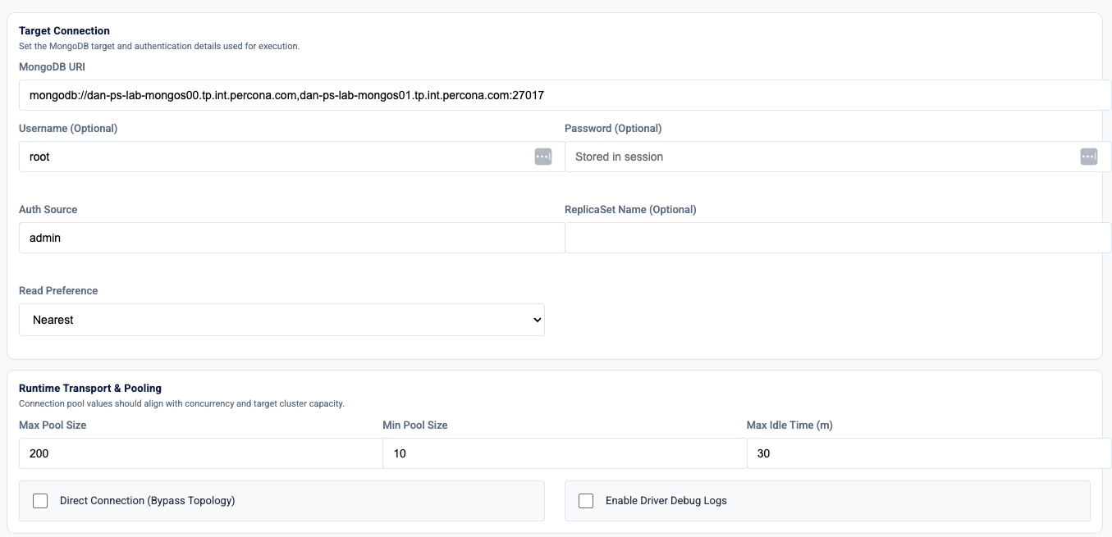
Client Settings

Slide 23
Realistic Query Patterns Reveal the Truth

Slide 24
Defining The Workload
Performance depends on how your application queries data
Operation mix matters: reads, writes, updates, aggregations, transactions
Query details matter: filters, sorting, limits, batch sizes, timeouts
Realistic tests must reflect actual application behavior

Slide 25
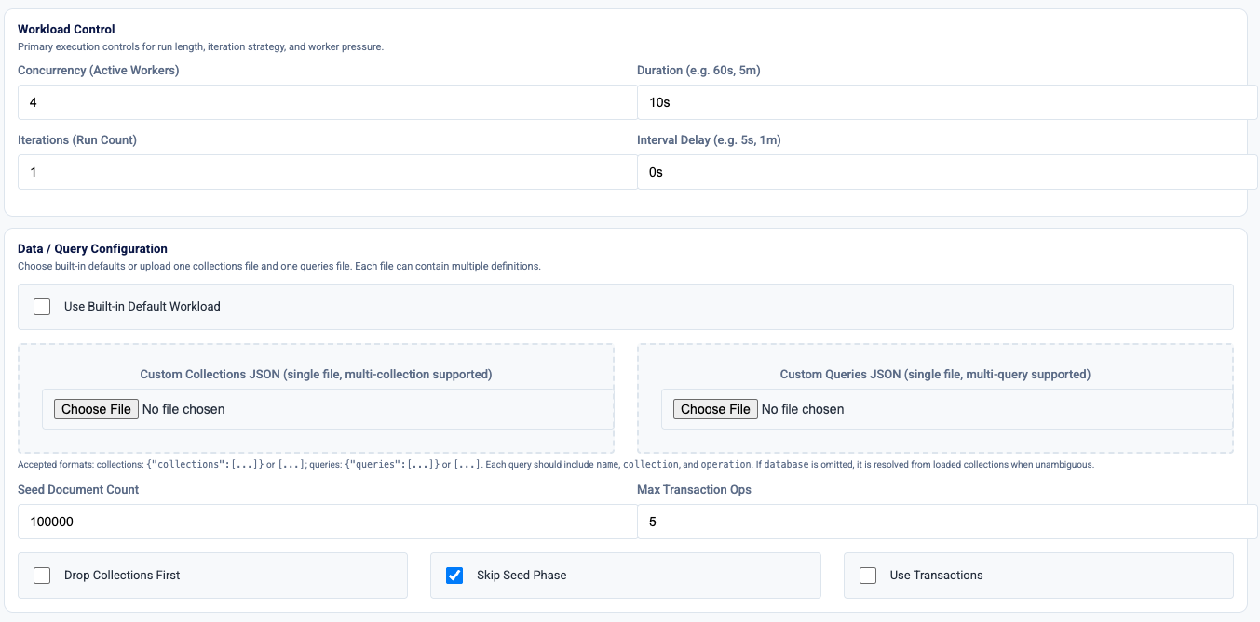
Workload Control

Slide 26
Define The Stress
Reads stress indexes, query execution, cache, and read paths
Writes stress journaling, replication lag, index maintenance, and disk I/O
Aggregations stress memory, sort/group stages, and pipeline efficiency
Transactions stress locking, coordination, retries, and end-to-end latency

Slide 27
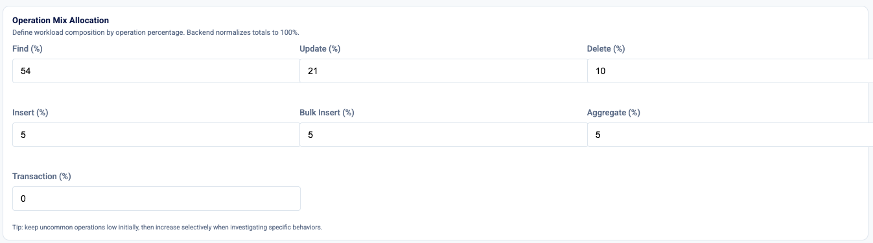
Operation Settings

Slide 28
If you can’t reproduce it, you can’t trust it — and you definitely can’t fix it.

Slide 29
From Test Run to Actionable Data
Export results during the run
Stitch multiple runs together to compare changes over time
Surface slow query groups and real hotspots
Prioritize work using severity and confidence — not guesswork

Slide 30
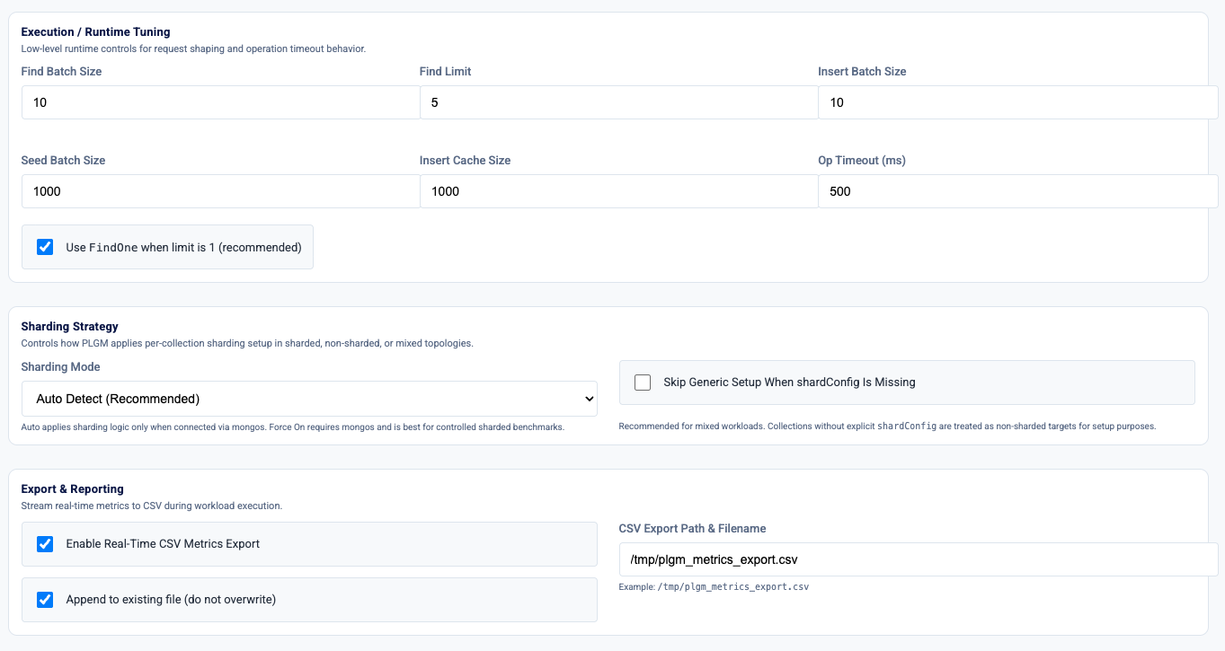
Execution Control and Metrics

Slide 31
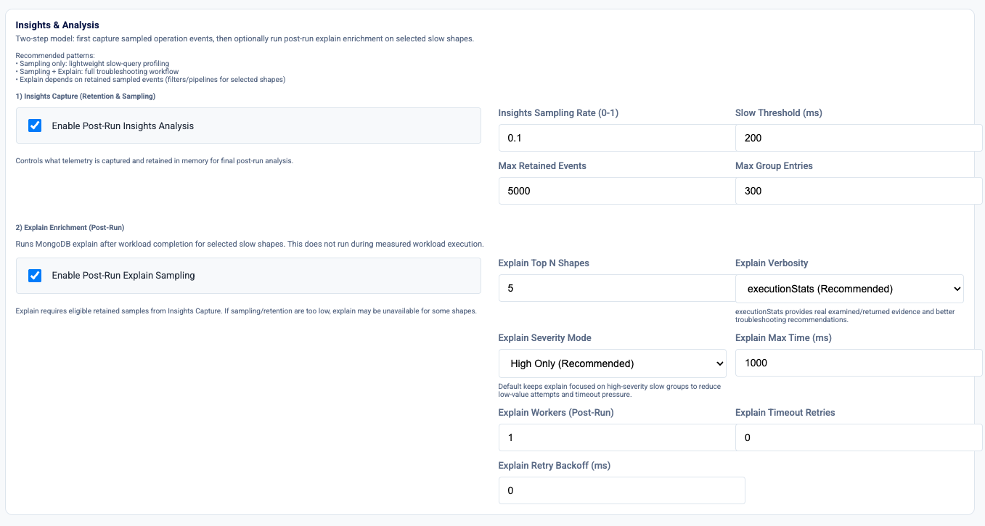
Insights And Analysis

Slide 32
You can push the system to its limits — or you can test how it actually behaves. Those aren’t the same thing.

Slide 33
Two Modes, Two Different Questions
Don’t confuse max throughput with real application behavior
Workflow mode: can this workload run cleanly on this design?
Raw Injector: how far can I push this cluster before it breaks?
Both are valid — but answer different questions

Slide 34
Raw Injector: Built for Stress, Not Behavior
Drives maximum load on network, disk, and cluster limits
Mimics the throughput profile of canned benchmarks for comparison
Useful for baseline stress and cross-tool comparisons

Slide 35
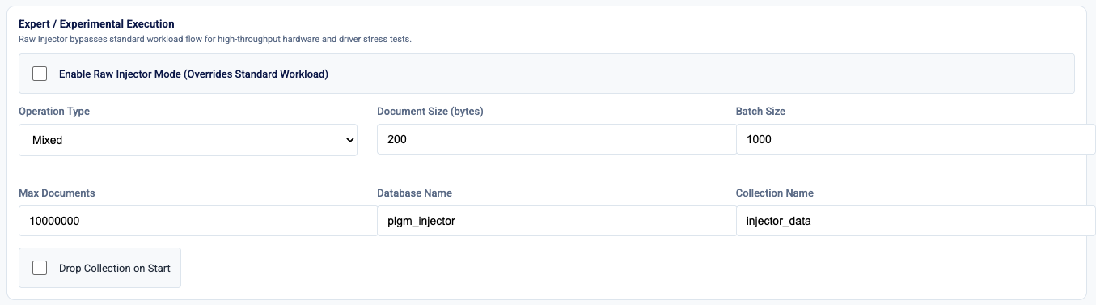
Raw Injector

Slide 36
From Workload To Insights

Slide 37
Live Telemetry Turns Tests Into Diagnosis

Slide 38
Live Throughput and Latency
Throughput alone doesn’t tell the story — watch how the system behaves over time
Break down ops/sec by operation type to see what’s driving load
Validate the workload mix — make sure what’s running matches what you configured

Slide 39
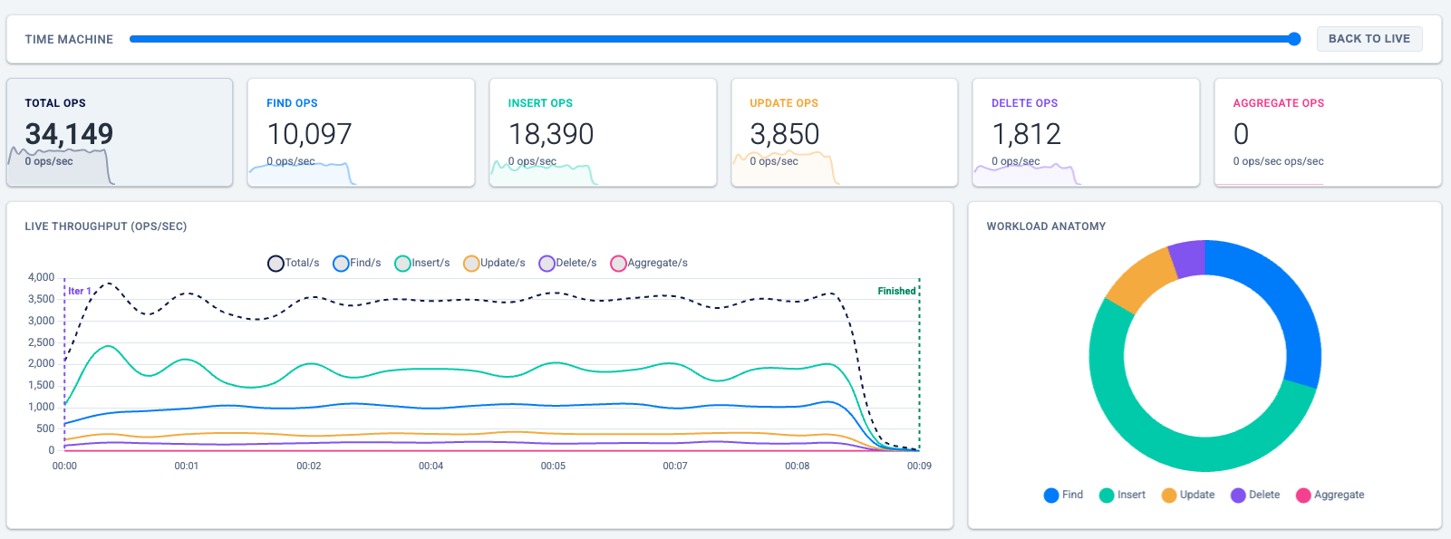
Live Throughput (ops/sec)

Slide 40
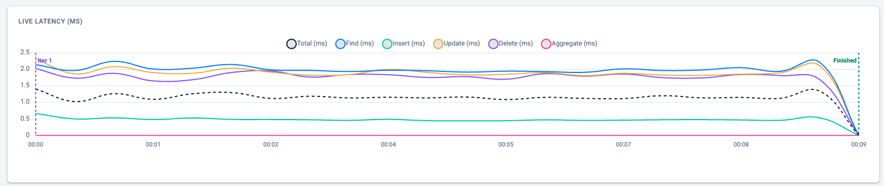
Live Latency

Slide 41
Latency Percentile
Track average and tail latency (p95/p99) — that’s where problems show up
Correlate spikes and drops — latency, throughput, and events should line up

Slide 42
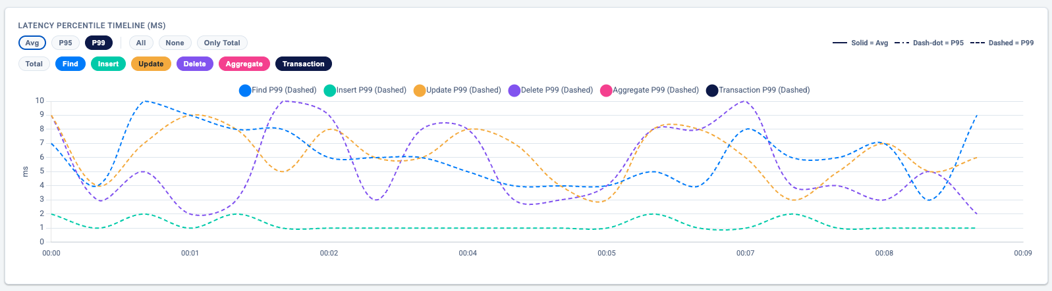
Latency Percentile

Slide 43
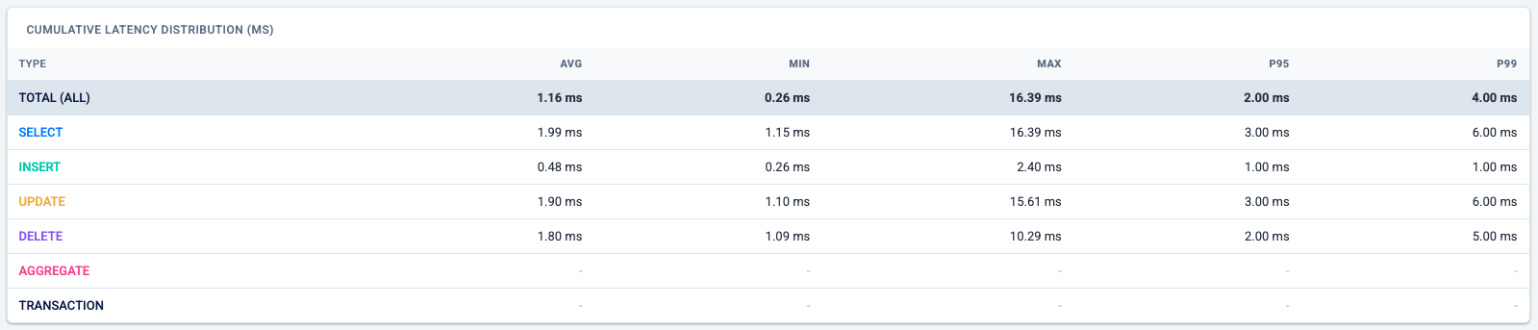
Cumulative latency

Slide 44
Find What’s Actually Hurting You
Groups slow operations into repeatable query patterns
Ranks issues by impact, not just frequency
Surfaces collections and queries driving latency
Points directly to what to investigate and fix first

Slide 45
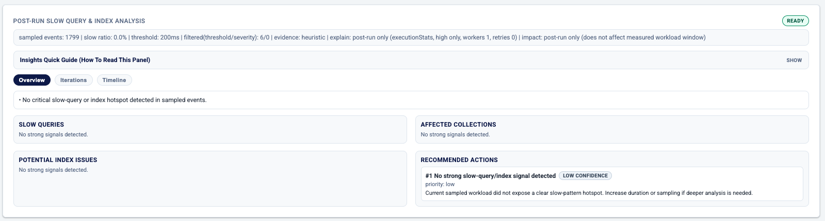
Slow Query Insights

Slide 46
Demo

Slide 47
Sample CSV – plgm_sample_export.csv
Timestamp,ElapsedSec,Total_OpsSec,Select_OpsSec,Insert_OpsSec,Upsert_OpsSec,Update_OpsSec,Delete_OpsSec,Agg_OpsSec,Trans_OpsSec,Total_Lat_P99,Select_Lat_P99,Insert_Lat_P99,Upsert_Lat_P99,Update_Lat_P99,Delete_Lat_P99,Agg_Lat_P99,Trans_Lat_P99,Iteration
2026-05-22T11:06:26-04:00,1,10970.00,3499.00,5730.00,0.00,1209.00,532.00,0.00,0.00,9.00,10.00,1.00,0.00,11.00,9.00,0.00,0.00,1
2026-05-22T11:06:27-04:00,2,12331.00,3819.00,6670.00,0.00,1198.00,644.00,0.00,0.00,7.00,9.00,1.00,0.00,13.00,8.00,0.00,0.00,1
2026-05-22T11:06:28-04:00,3,12693.00,3880.00,6840.00,0.00,1324.00,649.00,0.00,0.00,7.00,9.00,1.00,0.00,13.00,7.00,0.00,0.00,1
2026-05-22T11:06:29-04:00,4,11755.00,3642.00,6350.00,0.00,1108.00,655.00,0.00,0.00,10.00,14.00,1.00,0.00,14.00,11.00,0.00,0.00,1
2026-05-22T11:06:30-04:00,5,11479.00,3571.00,6060.00,0.00,1255.00,593.00,0.00,0.00,9.00,12.00,1.00,0.00,16.00,9.00,0.00,0.00,1
2026-05-22T11:06:31-04:00,6,11804.00,3838.00,6090.00,0.00,1248.00,628.00,0.00,0.00,8.00,10.00,1.00,0.00,11.00,9.00,0.00,0.00,1
2026-05-22T11:06:32-04:00,7,11994.00,3605.00,6500.00,0.00,1269.00,620.00,0.00,0.00,8.00,10.00,1.00,0.00,12.00,8.00,0.00,0.00,1

Slide 48
Sample Summary – plgm_summary_20260522151544.json
{
"generated_at": "2026-05-22T15:11:15.945Z",
"duration_seconds": "289.89",
"initialization_duration_seconds": "0.60",
"total_operations": 2001748,
"average_throughput_ops_sec": "6905.11",
"average_throughput_per_op": {
"find": "2176.37",
"insert": "3641.92",
"update": "726.00",
"delete": "360.83",
"aggregate": "0.00"
},
"operations": {
"find": 630915,
"insert": 1055770,
"update": 210462,
"delete": 104601,
"aggregate": 0
},

Slide 49

Key Takeaways
Model real workloads — query patterns, data, and concurrency
Convenience gives you numbers. Realism gives you answers.
Benchmark results only matter if they reflect real application behavior. Database performance is driven by workload — not just hardware. If your tests don’t match production, your results won’t either.
Focus on latency and behavior — not just ops/sec

Slide 50
Resources
Percona Load Generator for MongoDB: https://github.com/Percona-Lab/percona-load-generator-mongodb
PLGM: The Benchmark Tool That Simulates Your Actual Application: https://www.percona.com/blog/introducing-percona-load-generator-for-mongodb-clusters-the-benchmark-tool-that-simulates-your-actual-application/
The Importance of Realistic Benchmarks: https://www.percona.com/blog/the-importance-of-realistic-benchmark-workloads/

Slide 51

THANK
YOU

