Slide 1
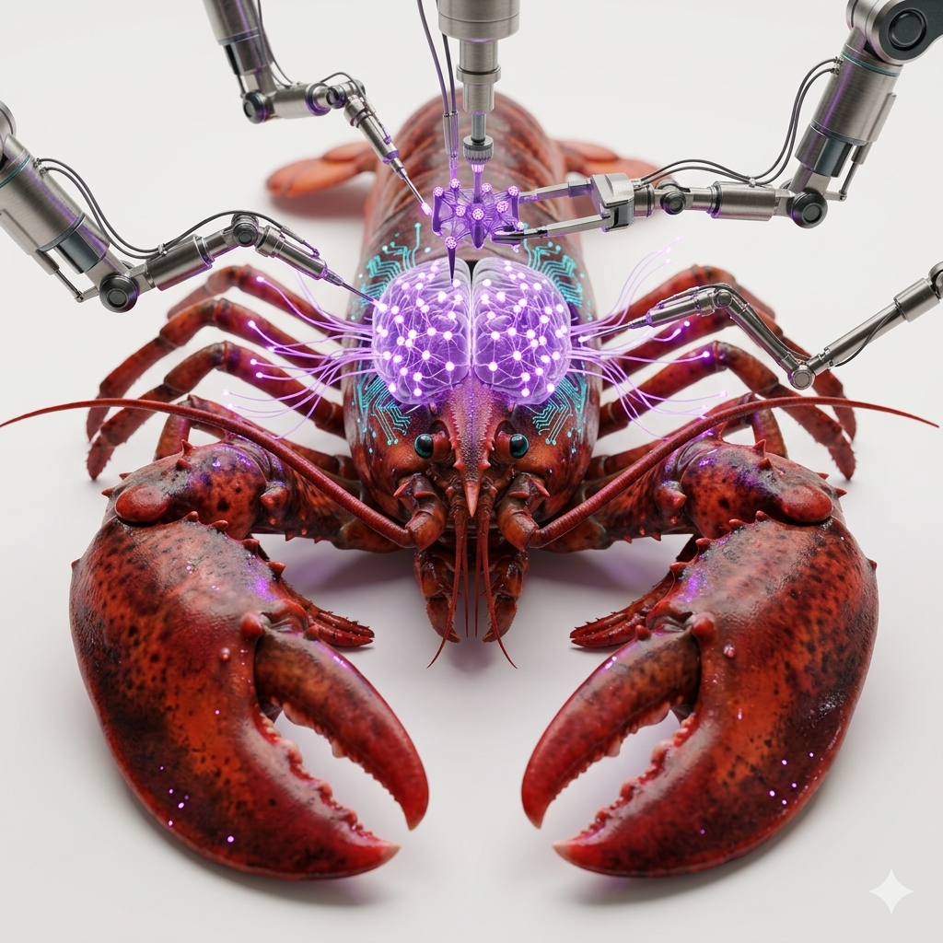

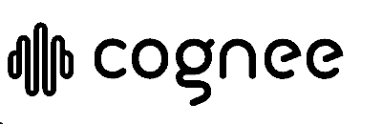
Giving Your AI Agent a Real Memory
Memory management framework for AI agents
Guy Lubovitch
Notes:
Hi everyone, I'm Guy Lubovitch from FalkorDB. Thanks for joining me at Percona Live.
This talk is about giving AI agents real memory — not just a bigger context window, and not just another vector index, but persistent memory the agent can use across conversations.
The stack I’ll walk through today is Telegram as the chat channel, OpenClaw as the agent runtime, Cognee as the memory control plane, and FalkorDB as the graph + vector database behind that memory.
The problem is agent amnesia: every new chat starts from zero unless the system can capture facts, organize relationships, and recall the right context later.
We’ll look at why graph-based memory matters, how Cognee orchestrates capture and recall, and how FalkorDB makes that memory queryable, explainable, and fast enough to run as part of a live agent workflow.

Slide 2
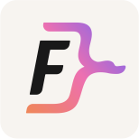

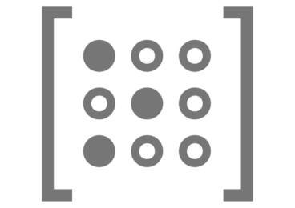

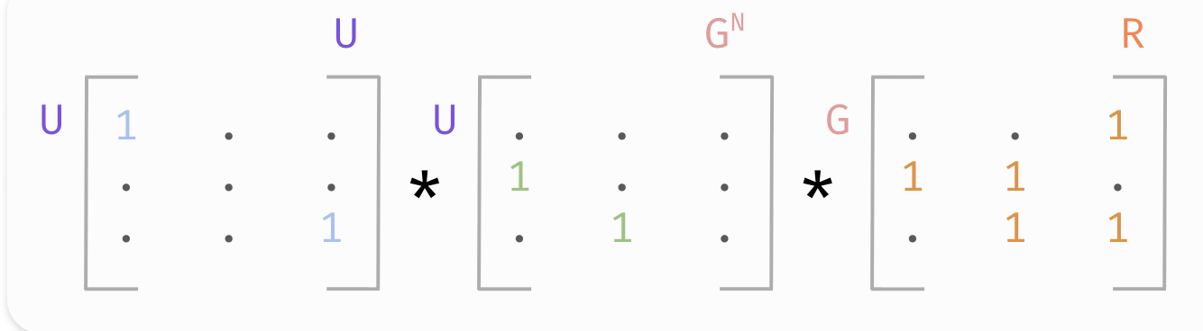
A market-proven technology
Ultra-fast, fully open-source graph database
Used by tier-1 enterprises
Built on RedisGraph technology
Supports vector + full-text search
Built-in multi-graph / multi-tenancy
Sparse matrix engine for speed
Notes:
Quick FalkorDB elevator pitch before we get into the agent memory story.
FalkorDB is an ultra-fast, open-source graph database built for connected data: knowledge graphs, GraphRAG, agent memory, fraud, security, and other relationship-heavy workloads.
The key idea is speed at graph scale. FalkorDB inherits the RedisGraph lineage and uses sparse matrices under the hood, so graph traversal becomes linear algebra — very efficient for multi-hop questions.
For AI applications, this matters because memory is not just a bag of text chunks. We need entities, relationships, vector search, full-text search, and tenant isolation working together in one system.
That is why FalkorDB is a strong fit for Cognee and OpenClaw here: Cognee orchestrates the memory, and FalkorDB gives it a fast, queryable graph + vector foundation.

Slide 3
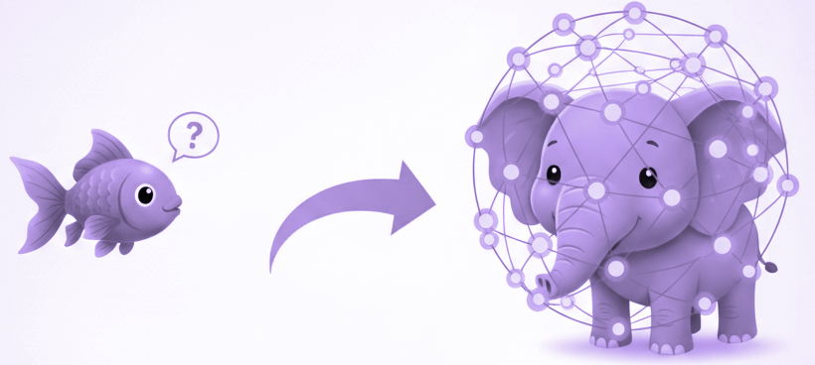
The Problem & Solution
From Goldfish to Elephant: AI Memory Evolution
The Problem:
Short-term memory (context window) forgets previous interactions once conversations end
Users experience pain: repeating preferences, projects, context
The Solution:
We deliver AI that recalls across sessions
We offer personalized experiences
We provide consistent interactions
Notes:
Let's start with how most people handle AI memory today. The common approach is markdown files or raw text chunks. You might have seen Karpathy's recent "LLM Wiki" project — it's a clean, simple markdown-based approach. But simplicity has a cost. Markdown stores flat text. There's no structure, no relationships. Every time your agent needs context, it has to re-parse everything, which is slow and burns through tokens. At scale, this becomes a real bottleneck — both in latency and cost.
Think about how most AI assistants work today — they're goldfish. The context window is their entire world, and the moment the conversation ends, everything disappears.
Users feel this pain daily: repeating their dietary preferences, re-explaining their project context, re-stating who they are. It's frustrating, and it breaks the illusion of intelligence.
Now, there are workarounds. You've probably seen Karpathy's "LLM Wiki" — a simple markdown-based memory system. It's elegant, but it stores flat text with no structure and no relationships. Every retrieval re-parses everything, which is slow and burns through tokens. Some people try vector databases — they find semantically similar content but they miss relationships entirely. At enterprise scale, both approaches become real bottlenecks in latency and cost.
Our solution transforms agents from goldfish into elephants. We deliver AI that recalls across sessions, offers personalized experiences, and maintains consistent interactions — all powered by graph-structured memory.
The key insight is: we're not just storing text, we're storing knowledge — entities and the relationships between them. That's a fundamentally different approach, and it changes everything about how retrieval works.

Slide 4
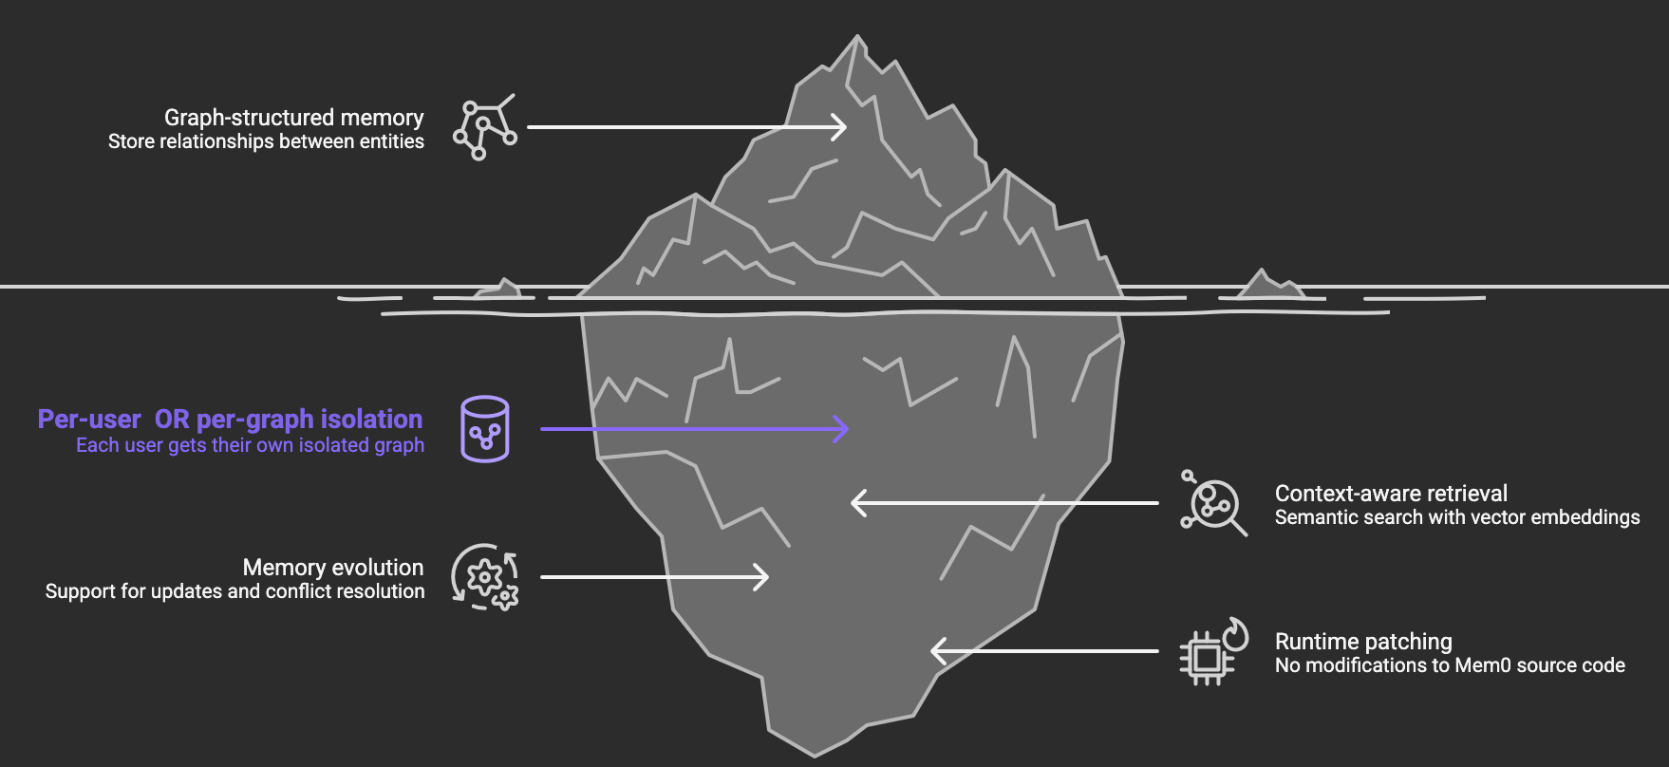
Notes:
This slide uses an iceberg metaphor intentionally. What you see above the waterline — graph-structured memory, storing relationships between entities — is the concept everyone's starting to talk about. But the real depth is below the surface.
First, per-user graph isolation. Each user automatically gets their own FalkorDB graph — mem0_alice, mem0_bob — completely separated. No data leakage, ever. This matters enormously for enterprise deployments where GDPR and data protection compliance are non-negotiable. Remember the 2024 Echoleak incident — a prompt hidden in an email caused an agent to leak private information from prior conversations because there was no session isolation. Our architecture prevents that by design.
Second, context-aware retrieval using vector embeddings combined with graph traversal. Vector search finds semantically relevant candidates, then graph traversal refines results using actual structural relationships. As our CEO Guy Korland says: this is the best hybrid combination for knowledge storage and retrieval, and the benchmarks back it up — GraphRAG improves precision by up to 35% over vector-only retrieval.
Third, memory evolution — new interactions update existing nodes or create new connections. The memory grows and evolves with the user over time. It's not a static snapshot; it's a living knowledge structure.
And here's the engineering trick that makes this practical: runtime patching. The mem0-falkordb plugin registers FalkorDB into Mem0's existing factory system without modifying a single line of Mem0's source code. Import the plugin, configure it, and you're running graph memory. Zero forks required. That means you get all of Mem0's ecosystem — the auto-capture, the auto-recall, the memory tools — with FalkorDB's performance and isolation underneath.

Slide 5
Telegram Chat → OpenClaw Agent Memory Stack
OpenClaw runs the agent on Ubuntu; Cognee is the memory control plane; FalkorDB stores the connected memory graph.
Ubuntu host · local agent stack
Telegram
OpenClaw
Cognee
FalkorDB
Chat channel
Agent runtime
Memory control plane
Graph database
user messages
Telegram connector + tools
Extract → Cognify → Load
:6379 API · :3000 browser
User talks to the agent through a Telegram bot.
Runs the agent loop, tools, and memory calls.
Orchestrates entities, relationships, embeddings, recall, and updates.
Stores the connected memory graph for fast Cypher traversal and relationship-aware recall.
← Graph context returns through Cognee to OpenClaw, then back to Telegram
Notes:
This slide shows the actual architecture we are using for the demo. Telegram is not the agent — it is just the chat channel where the user interacts with the system.
On the Ubuntu host, OpenClaw runs the agent runtime. It receives the Telegram events, manages the agent loop, calls tools, and decides when memory needs to be captured or recalled.
Cognee sits between the agent and the database as the memory control plane. In Cognee’s own framing, it turns data into usable agent memory — extracting information, cognifying it into entities and relationships, and loading it into the memory backend.
FalkorDB is the graph database in this architecture. It stores the connected memory graph, so the agent can retrieve facts by traversing explicit relationships instead of relying only on similar text.
GraphRAG is a related use case we can talk about later, but for this slide the important point is simpler: FalkorDB is the fast graph database backing long-term agent memory.
The system is one local stack: Telegram on the outside, then OpenClaw, Cognee, and FalkorDB running together on Ubuntu. The agent is not starting from a blank prompt every time; it can recall structured context from previous interactions.

Slide 6




Meet the Agents
Two specialized agents, two isolated memory graphs — one seamless experience
Will
Liz (Elizabeth)
Work Agent
Personal Agent
Handles professional tasks, projects, meetings, and workplace knowledge.
Manages personal life - hobbies, family, travel, and everyday activities.
• Meetings & scheduling
• Projects & deliverables
• Team collaboration
• Technical workflows
• Family & relationships
• Hobbies & fitness
• Travel & experiences
• Food, dining & lifestyle

Slide 7
Demo: Agent Memory in Action
Watch the Telegram → OpenClaw → Cognee → FalkorDB flow end-to-end.
VIDEO DEMO
This is the demo
A short walkthrough of the live agent memory stack running as one system.
https://screen.studio/share/NZkqSZZ1

Slide 8
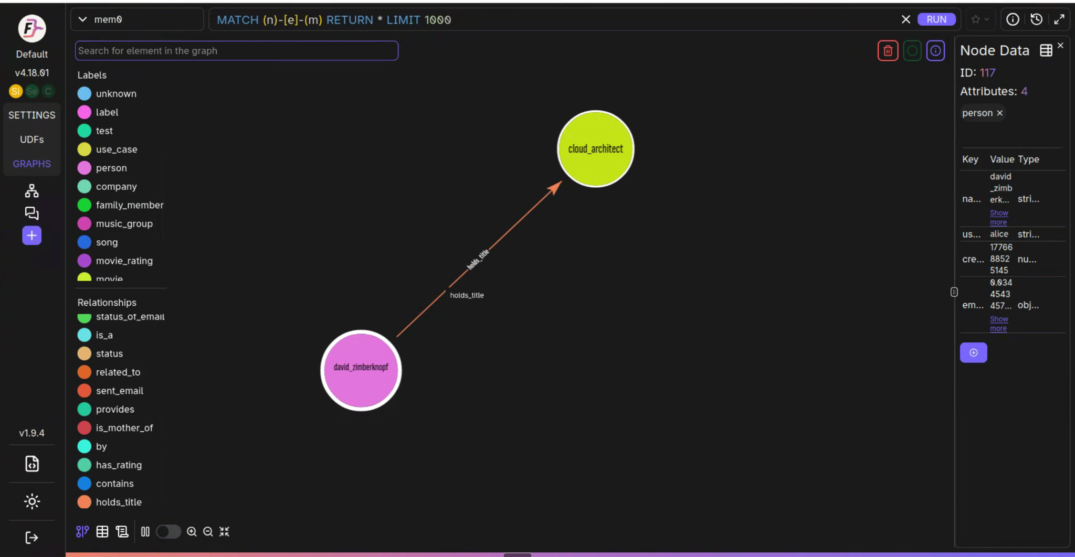

OpenClaw Memory & Relationship Example
Notes:
Here's what this looks like in practice. This is a real screenshot from our OpenClaw demo. OpenClaw is an open-source personal AI assistant that runs locally on your device — think of it as your own private AI that works across any platform. We've integrated it with Mem0 and FalkorDB for persistent graph memory.
What you're looking at is the FalkorDB Browser showing a user's memory graph. The query at the top — MATCH (n) OPTIONAL MATCH (n)-[e]-(m) RETURN * LIMIT 100 — is pulling all nodes and their connections.
Notice the two highlighted nodes: "wife" and "son" — these are family_member entities that the agent automatically extracted from natural conversation. The user didn't fill out a form or structure their data. They just talked naturally, and the system built this knowledge graph.
On the right panel you can see the node details: ID 96, labeled family_member, with attributes including name, user_id (alice), creation timestamp, and critically — a vector embedding. That embedding is what enables semantic search alongside the graph structure.
Look at the labels on the left side: person, communication, event, time, software, concept, email, operating_system — all automatically categorized from conversations. And the relationships: is, status_of_email, related_to, from, sent_email, provides, is_mother_of. This is structured knowledge extracted automatically from natural language.
The OpenClaw + Mem0 + FalkorDB demo is open source on our GitHub if you want to try it yourself.

Slide 9

Notes:
You → OpenClaw Web UI (:18789) → OpenClaw Gateway (systemd user unit)
→ Agents (Will + Liz) → openclaw-cognee plugin (autoCapture + autoRecall)
→ cognee sidecar (FastAPI / uvicorn, HTTP :8765)
→ Cognee 1.0.3 cognify pipeline
→ FalkorDB (:6379) + FalkorDB Browser (:3000)
→ cognee metadata → cognee_db SQLite
Config (5 lines in ~/.openclaw/openclaw.json):
userId, sidecarUrl, autoCapture: true, autoRecall: true

Slide 10
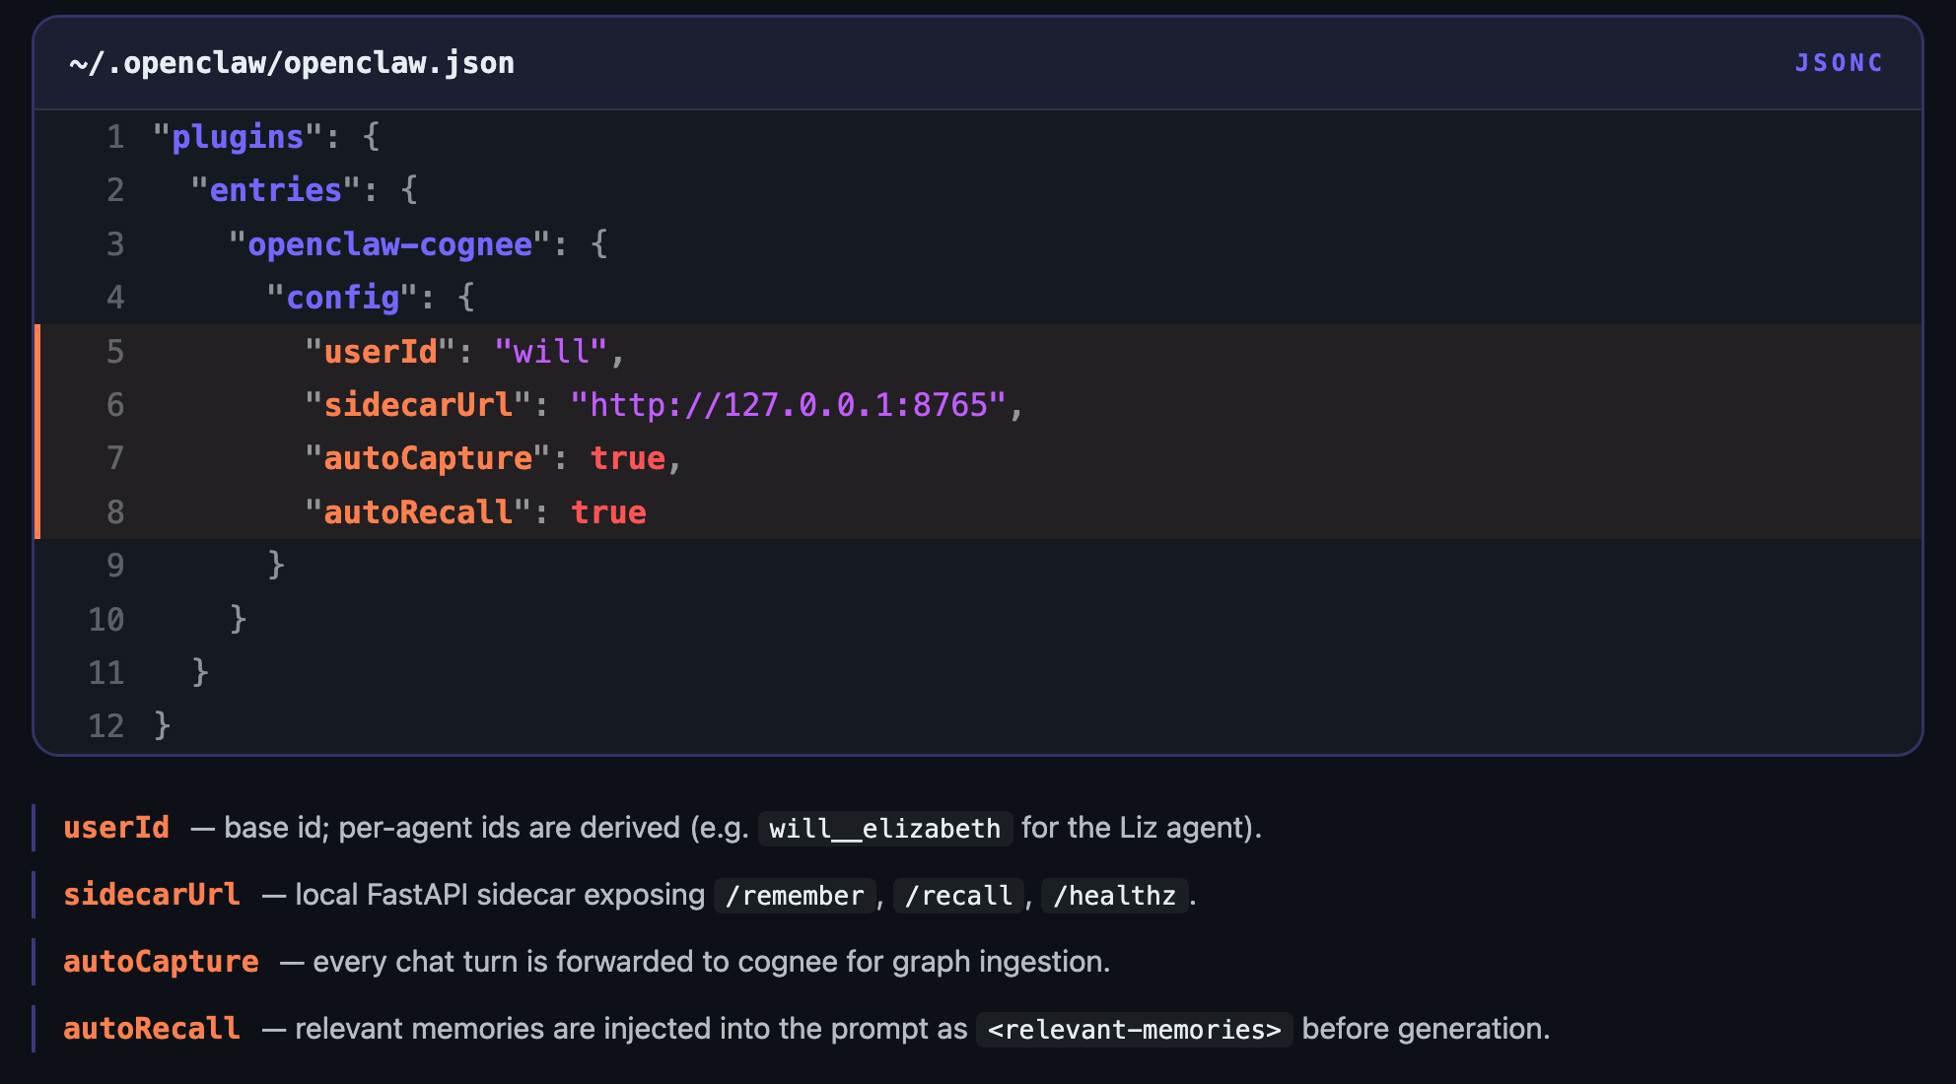
Notes:
You → OpenClaw Web UI (:18789) → OpenClaw Gateway (systemd user unit)
→ Agents (Will + Liz) → openclaw-cognee plugin (autoCapture + autoRecall)
→ cognee sidecar (FastAPI / uvicorn, HTTP :8765)
→ Cognee 1.0.3 cognify pipeline
→ FalkorDB (:6379) + FalkorDB Browser (:3000)
→ cognee metadata → cognee_db SQLite
Config (5 lines in ~/.openclaw/openclaw.json):
userId, sidecarUrl, autoCapture: true, autoRecall: true

Slide 11
Graph-Based Long-Term Memory
Graphs = Smarter, Persistent AI Memory
Example: Graph Traversal
Query: "What should Alice eat in Japan?"
(Alice) --[:FOLLOWS_DIET]--> (Vegan)
(Alice) --[:ALLERGIC_TO]--> (TreeNuts)
(Alice) --[:TRAVELING_TO]--> (Japan)
=> Recommend vegan, nut-free Japanese cuisine
Notes:
This is where graph memory clicks for people. Let's walk through a concrete query.
A user asks: "What should Alice eat in Japan?"
With a vector-only approach, the system would search for text chunks semantically similar to "eating in Japan" — and might return generic Japanese food recommendations. It has no structured way to know Alice is vegan or allergic to tree nuts unless those facts happened to be in a nearby text chunk. And even if they were, there's no guarantee they'd be retrieved together.
With graph memory, the agent starts at Alice's node and traverses her relationships. Three hops:
Alice FOLLOWS_DIET Vegan
Alice ALLERGIC_TO TreeNuts
Alice TRAVELING_TO Japan
Three critical facts, retrieved in under 140 milliseconds, from a structured knowledge graph. The agent now has everything it needs to recommend vegan, nut-free Japanese cuisine — dishes like shojin ryori, which is Buddhist temple cuisine, vegetable sushi, or tofu-based ramen.
This is the difference between "similar text" and "actual knowledge." The graph doesn't guess — it traverses verified relationships. And this multi-hop reasoning is exactly where standard RAG falls short. Recent benchmarks show GraphRAG at 92% recall and 88% precision versus standard RAG at 85% recall and 75% precision. That gap matters in production.

Slide 12
Fast graph memory retrieval.
Simple developer experience.
from mem0 import Memory
from mem0_falkordb import FalkorDBGraphStore
config = {
"graph_store": {
"provider": "falkordb",
"config": {
"host": "localhost",
"port": 6379,
}
}
}
m = Memory.from_config(config)
# Add memories (auto-creates user graph)
m.add("I love hiking in Japan",
user_id="alice")
# Search across relationships
results = m.search(
"outdoor activities",
user_id="alice"
)
Notes:
This is where graph memory clicks for people. Let's walk through a concrete query.
A user asks: "What should Alice eat in Japan?"
With a vector-only approach, the system would search for text chunks semantically similar to "eating in Japan" — and might return generic Japanese food recommendations. It has no structured way to know Alice is vegan or allergic to tree nuts unless those facts happened to be in a nearby text chunk. And even if they were, there's no guarantee they'd be retrieved together.
With graph memory, the agent starts at Alice's node and traverses her relationships. Three hops:
Alice FOLLOWS_DIET Vegan
Alice ALLERGIC_TO TreeNuts
Alice TRAVELING_TO Japan
Three critical facts, retrieved in under 140 milliseconds, from a structured knowledge graph. The agent now has everything it needs to recommend vegan, nut-free Japanese cuisine — dishes like shojin ryori, which is Buddhist temple cuisine, vegetable sushi, or tofu-based ramen.
This is the difference between "similar text" and "actual knowledge." The graph doesn't guess — it traverses verified relationships. And this multi-hop reasoning is exactly where standard RAG falls short. Recent benchmarks show GraphRAG at 92% recall and 88% precision versus standard RAG at 85% recall and 75% precision. That gap matters in production.

Slide 13
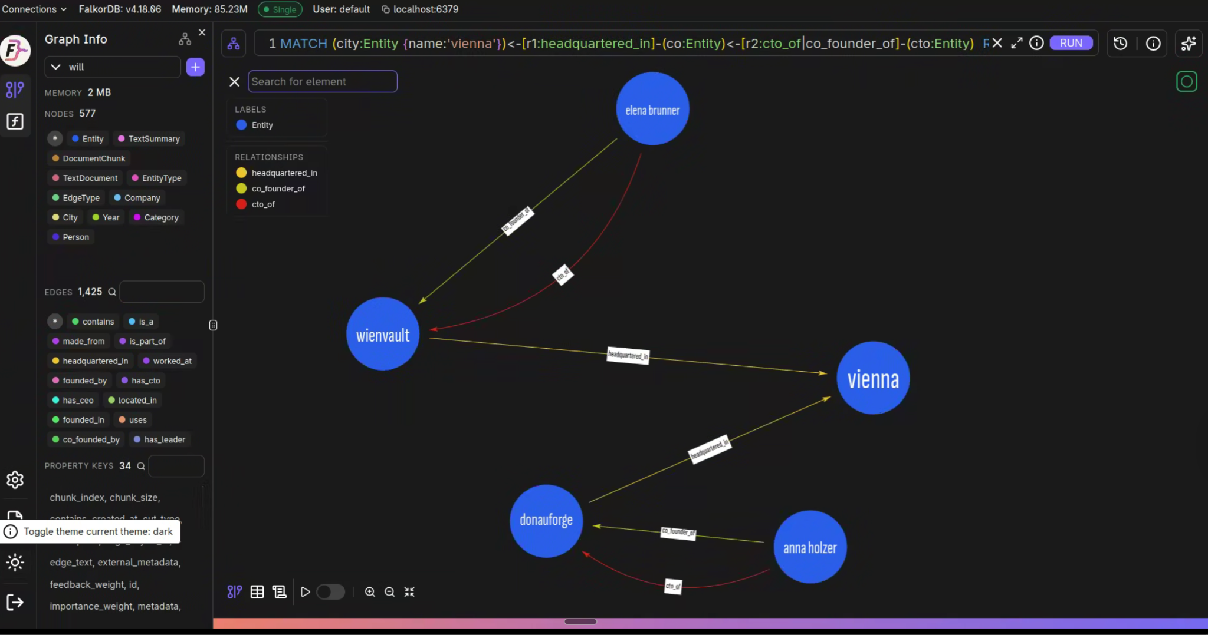
Creating Connections and Edges

Slide 14
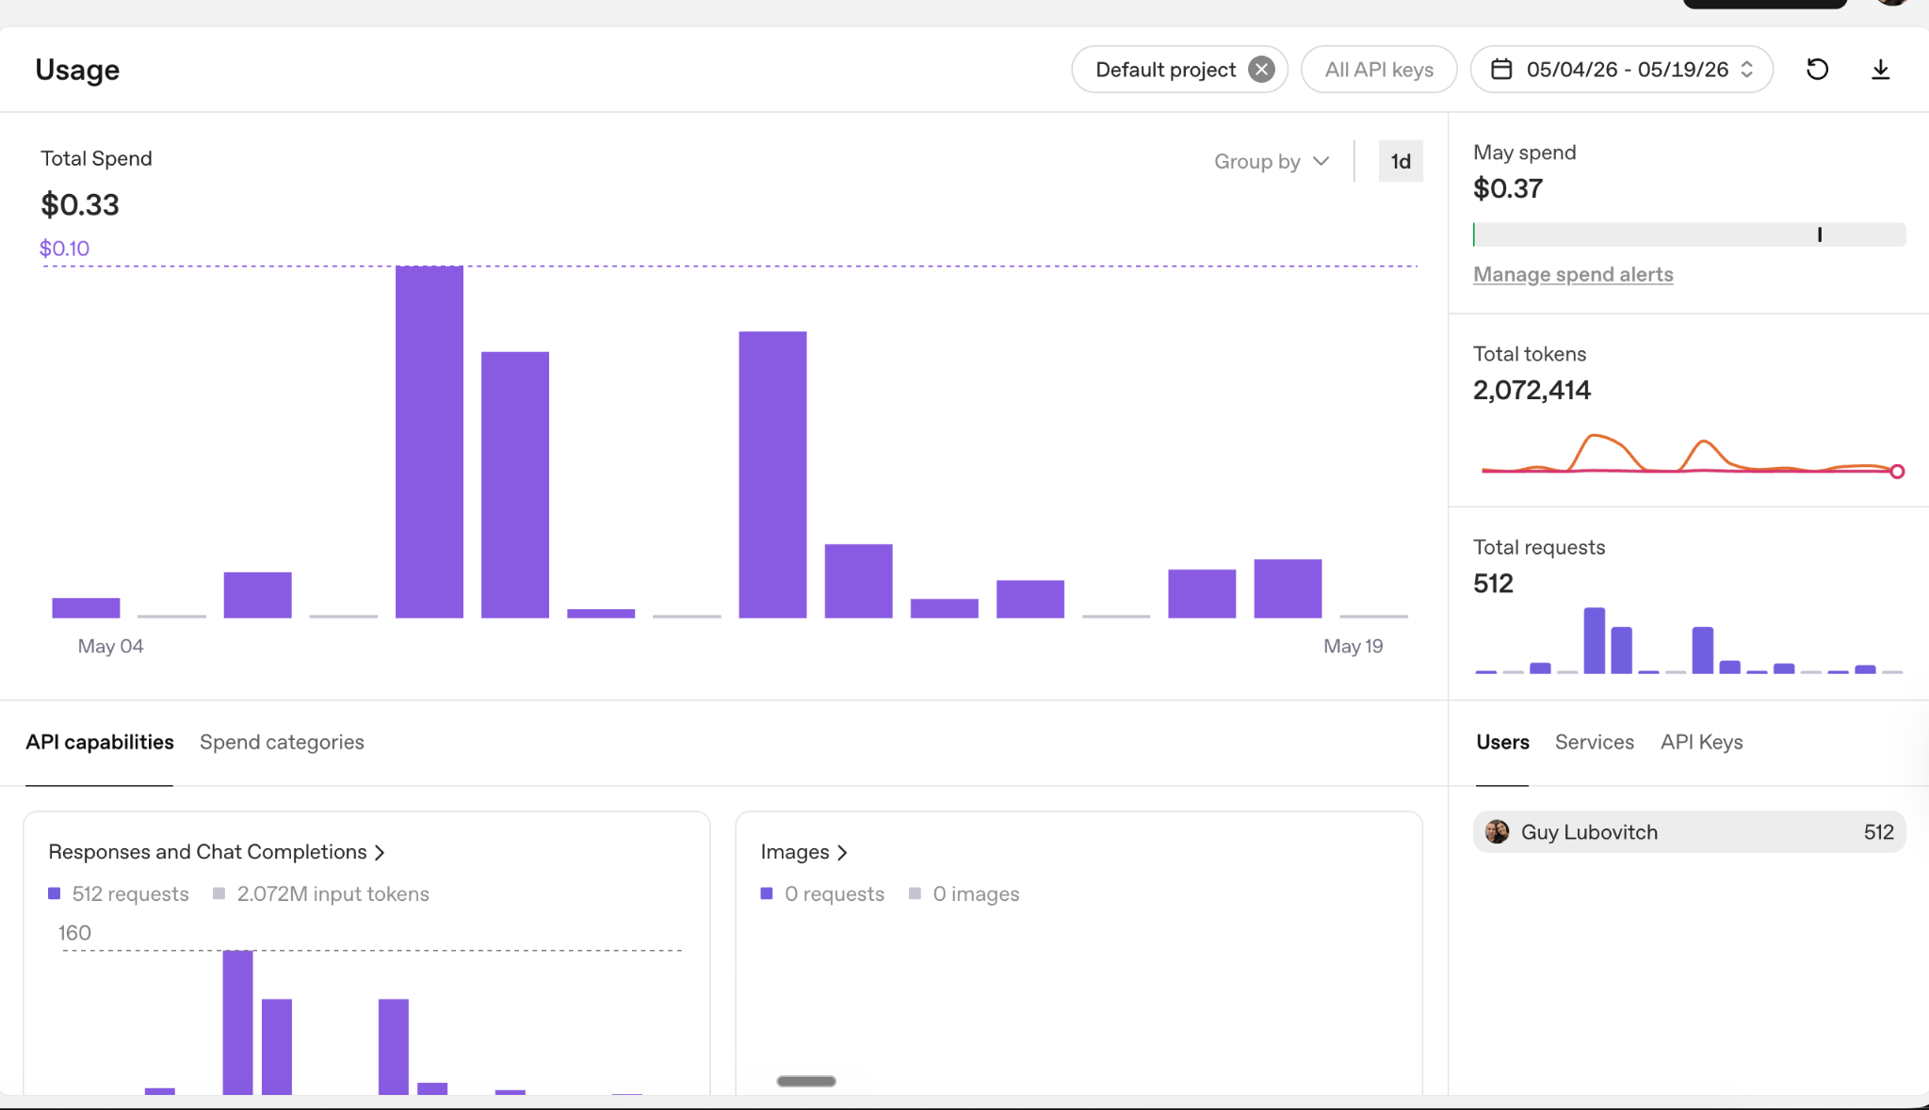
Token Usage to Support Your Memory

Slide 15
Why Graph Memory > Vector-Only Memory
Vector RAG: retrieves chunks independently - can't do the join across entities
Works fine until:
• A message implies "Chicago" without saying it (no text match)
• Top-k retrieval drops one company
• The question requires 3+ hops instead of 2

Slide 16
10K+ Multi-Graph (Tenants)
Horizontal Scaling
Data Model Flexibility
Near-real-time
Vector Capabilities
Hybrid Search
Notes:
This slide highlights why FalkorDB is purpose-built for agentic memory at enterprise scale. Let me walk through each capability.
10K+ Multi-Graph Tenants — this is the isolation story. FalkorDB can manage over 10,000 separate graphs on a single instance. Each user, each agent, each tenant gets their own graph. Creating a new graph is lightweight — there's no provisioning overhead. When a new user signs up, their memory graph exists instantly.
Horizontal Scaling — as your user base grows, FalkorDB scales out horizontally. You're not locked into a single server. This matters when you're running thousands of concurrent agent sessions. And FalkorDB requires 7x less memory than competing graph databases to hold the same dataset — so your infrastructure costs stay sane.
Data Model Flexibility — FalkorDB is a property graph database, so your schema evolves with your needs. You don't need to define everything upfront. Add new node types, relationship types, and properties as your agent's understanding grows. This flexibility matters because you can't predict what an AI agent will need to remember.
Near-real-time — sub-millisecond for point lookups, sub-140ms for complex traversals. Memory retrieval is in the hot path of every user interaction. If it takes seconds, the user experience suffers.
Vector Capabilities — FalkorDB has native vector indexing built in. You don't need a separate vector database. Embeddings live right alongside your graph nodes. One database, not three.
Hybrid Search — this is the key differentiator. You can combine graph traversal, vector similarity search, and full-text search in a single query. Graph for relationships, vectors for semantics, full-text for exact matches. All unified in one database, one query language, no glue code.
Under the hood, this all runs on GraphBLAS — FalkorDB represents graphs as sparse adjacency matrices and uses linear algebra for query execution. It's the first property graph database to use this approach, and it's why the performance numbers are what they are.

Slide 17

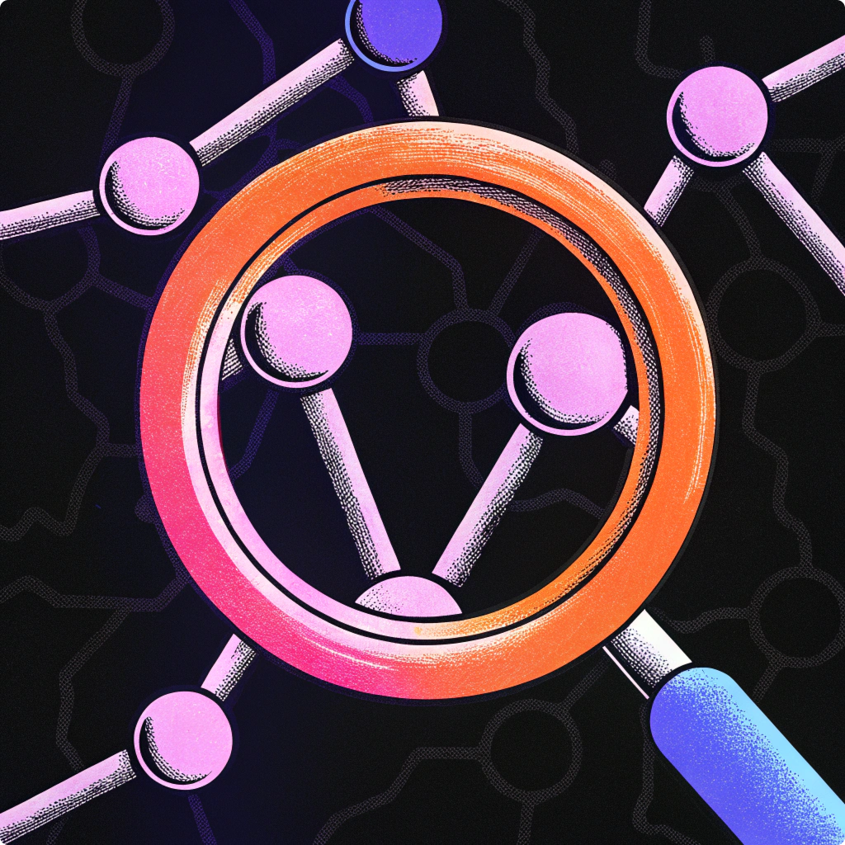
Thank you!
@falkordb (LinkedIn/X)
Connect on Discord
🔗 falkordb.com
Notes:
To wrap up — the AI agents market is approaching $11 billion this year, and 40% of enterprise applications will embed agents by the end of 2026. But agents without memory are agents without value. They can't personalize. They can't build on past interactions. They can't earn user trust.
Graph memory isn't optional for serious agentic AI. It's essential. And FalkorDB gives you everything you need to make it work:
The performance — sub-140ms retrieval, up to 500x faster than alternatives, 7x more memory-efficient.
The privacy — per-user graph isolation by design, 10K+ tenant support.
The developer experience — six lines of config to integrate with Mem0, runtime patching with zero source modifications.
And the architecture — hybrid graph, vector, and full-text search, unified in one database, powering both enterprise knowledge and personalized memory.
Scan the QR code to get started. We're open source. You can be running in minutes. Find us on LinkedIn and X at @falkordb, join our Discord community, or visit falkordb.com.
I'd love to chat more after this. Thank you!

Slide 18
Graph-Based Long-Term Memory
Graphs = Smarter, Persistent AI Memory
How it works:
Nodes store facts, preferences, projects
Edges define relationships between them
AI fetches relevant nodes dynamically during retrieval
Benefits:
Context-rich personalization
Intelligent connections between past interactions
Persistent memory with controlled relevance and privacy
Notes:
Let me break down how graph memory actually works.
Nodes are the "what" — they store facts, preferences, projects, and user interactions as discrete entities. Alice is vegan. Bob works at Acme. The Q4 project deadline is March 15th. Each node can also carry a vector embedding for semantic search.
Edges are the "how they connect" — typed relationships between nodes. FOLLOWS_DIET, ALLERGIC_TO, WORKS_ON, REPORTS_TO. These aren't just labels — they're semantically meaningful connections that let the agent reason about relationships. This is something flat text and pure vector search simply cannot do.
At query time, the AI traverses the relevant subgraph dynamically using multi-hop Cypher queries. It doesn't scan a wall of text — it navigates a knowledge structure. And because FalkorDB uses sparse adjacency matrices with GraphBLAS under the hood, these traversals happen in milliseconds, not seconds.
The benefits follow directly. Context-rich personalization — because the agent actually understands relationships, not just text similarity. Intelligent connections between past interactions — the agent can discover that two seemingly unrelated facts are connected through a shared entity. Persistent memory that survives across sessions — no more amnesia. And privacy built in — because each user has their own isolated graph, data never bleeds between users or between agents.

Slide 19
Performance & DX
Fast graph memory retrieval with a dead-simple developer experience.
<140ms
Sub-140ms graph traversal
for memory retrieval
Quick Start
from mem0 import Memory
from mem0_falkordb import FalkorDBGraphStore
config = {
"graph_store": {
"provider": "falkordb",
"config": {
"host": "localhost",
"port": 6379,
}
}
}
m = Memory.from_config(config)
# Add memories (auto-creates user graph)
m.add("I love hiking in Japan",
user_id="alice")
# Search across relationships
results = m.search(
"outdoor activities",
user_id="alice"
)
Query Latency
91%
Compared to vector-only
retrieval approaches
Faster Responses
90%
Hybrid retrieval mode
reduces LLM token usage
Lower Token Cost
Notes:
Let's talk numbers — because performance isn't theoretical here, and developer experience matters just as much.
Sub-140 milliseconds for graph memory retrieval. To put that in perspective, our benchmarks show FalkorDB delivers p99 latency under 140ms while Neo4j reaches 46.9 seconds for comparable operations. That's up to 500x faster at the tail. And this isn't just lab numbers — Securin, an AI cybersecurity company, migrated to FalkorDB and achieved 0.3-second latencies on complex 7-hop queries while eliminating a 25% query failure rate they had with their previous graph provider.
At batch processing of 5,000 operations, FalkorDB reaches 22,784 operations per second — 77x its single-operation throughput — while Neo4j plateaus around 10,600 regardless of batch size.
91% faster than vector-only retrieval approaches. Because we traverse relationships directly instead of scanning through embedding similarity across large corpuses.
90% lower token cost. This is huge for production economics. Graph memory transmits structured triples — compact, precise facts — instead of raw text chunks. Every API call your agent makes costs less because the context is smaller, more targeted, and more relevant. In internal tests, response accuracy for enterprise questions jumped from 56% to over 90%.
Now look at the code on the right — this is the actual developer experience. Import Memory from mem0, import FalkorDBGraphStore from our plugin, set a config with host and port, and you're running. Six lines of config. No infrastructure changes, no Mem0 source modifications. Add a memory with m.add(), search with m.search(). The developer experience is dead simple because the complexity is handled under the hood.

Slide 20
Graph-Based Long-Term Memory
Graphs = Smarter, Persistent AI Memory
How It Works
Benefits
Nodes
Context-rich personalization across sessions
store facts, preferences, projects, and
user interactions as discrete entities
Intelligent connections between past interactions
Persistent memory with controlled relevance
Edges
Privacy built-in: per-user graph isolation
define typed relationships between nodes
(e.g., FOLLOWS_DIET, ALLERGIC_TO, WORKS_ON)
Retrieval
Example: Graph Traversal
AI traverses relevant subgraph dynamically
at query time via multi-hop Cypher queries
Query: "What should Alice eat in Japan?"
(Alice) --[:FOLLOWS_DIET]--> (Vegan)
(Alice) --[:ALLERGIC_TO]--> (TreeNuts)
(Alice) --[:TRAVELING_TO]--> (Japan)
=> Recommend vegan, nut-free Japanese cuisine
Updates
new interactions update existing nodes or
create new connections — memory evolves
FalkorDB

Slide 21
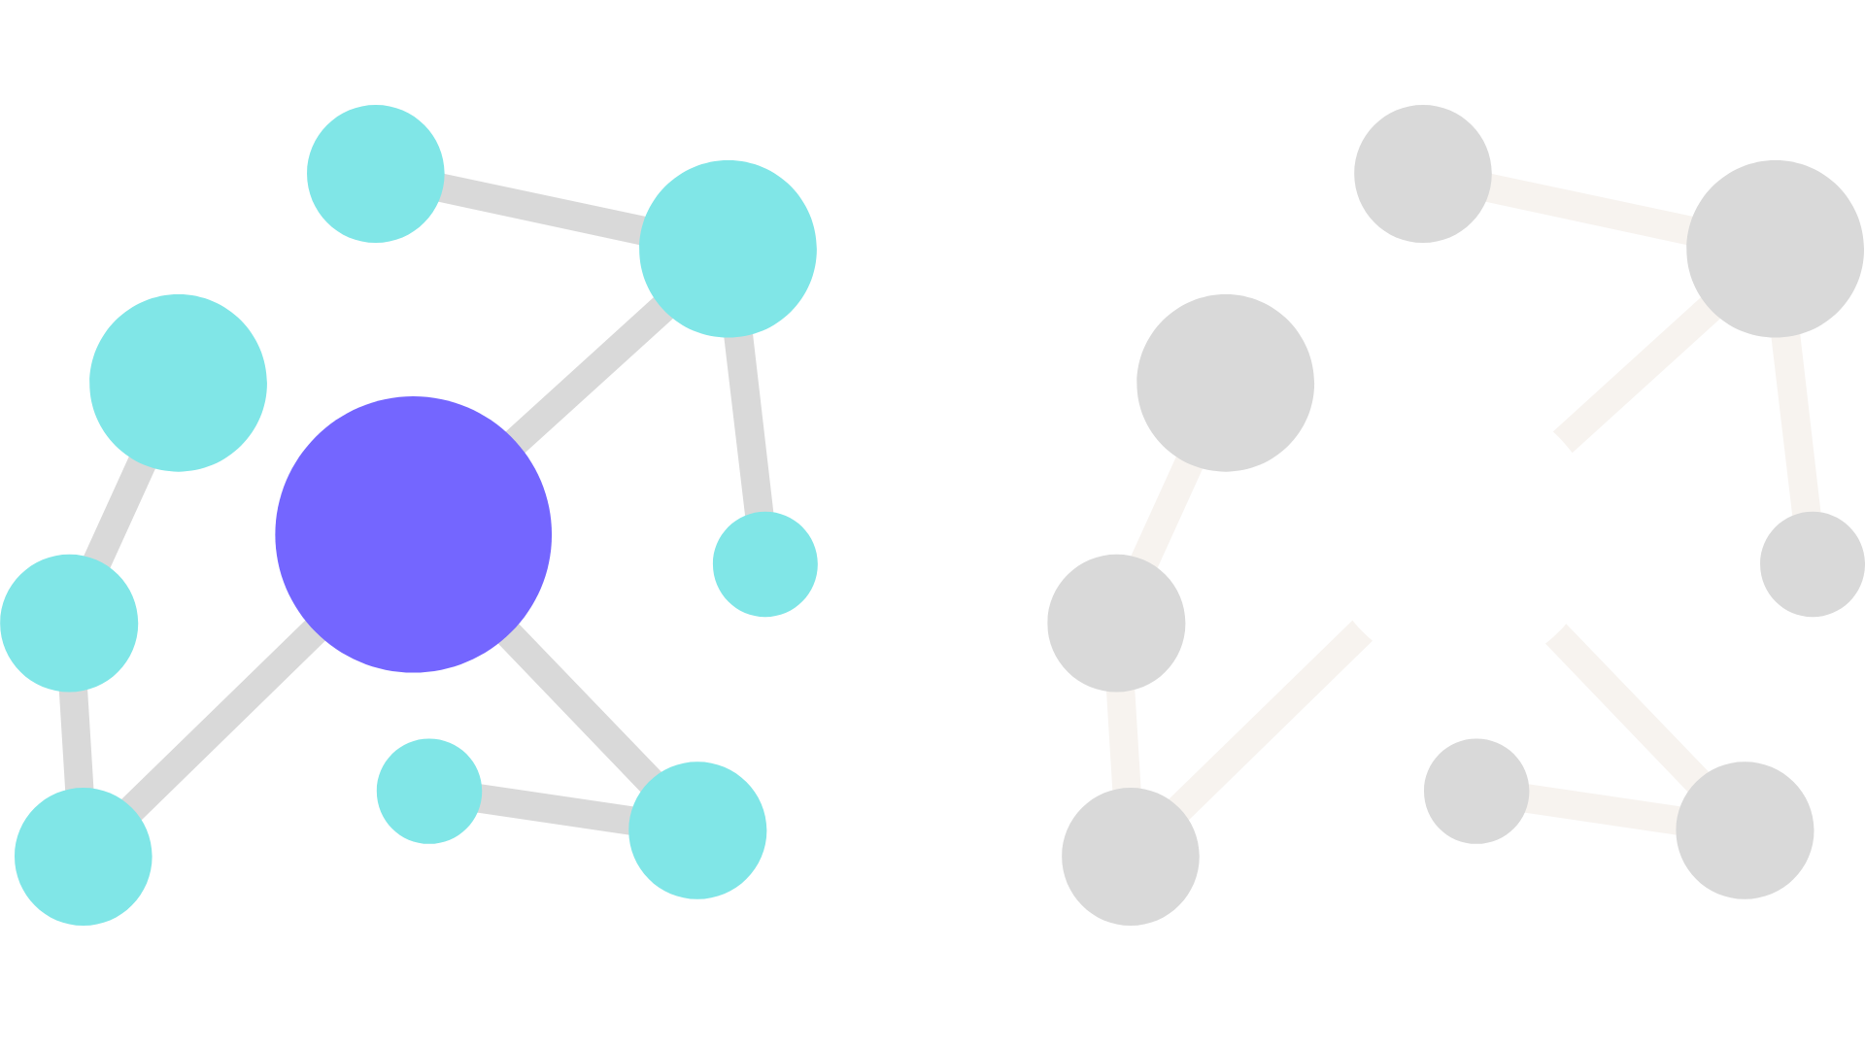
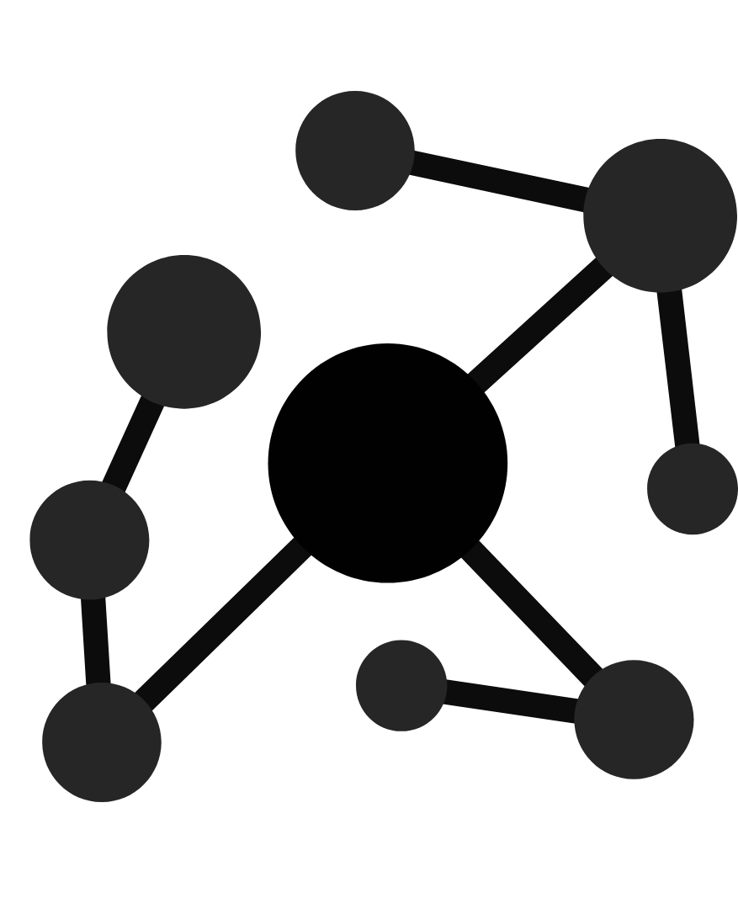
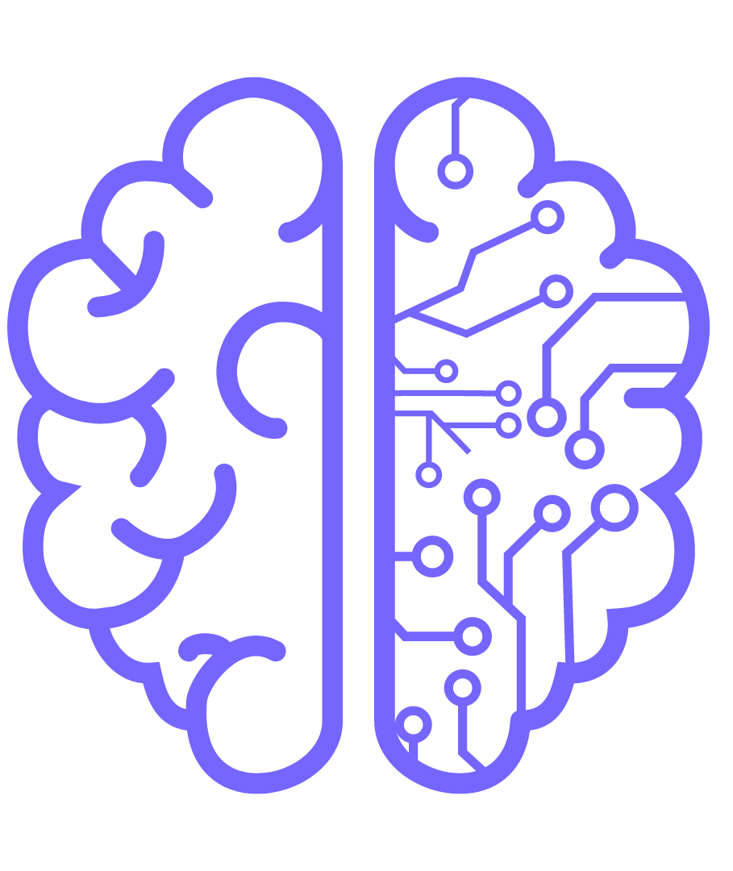
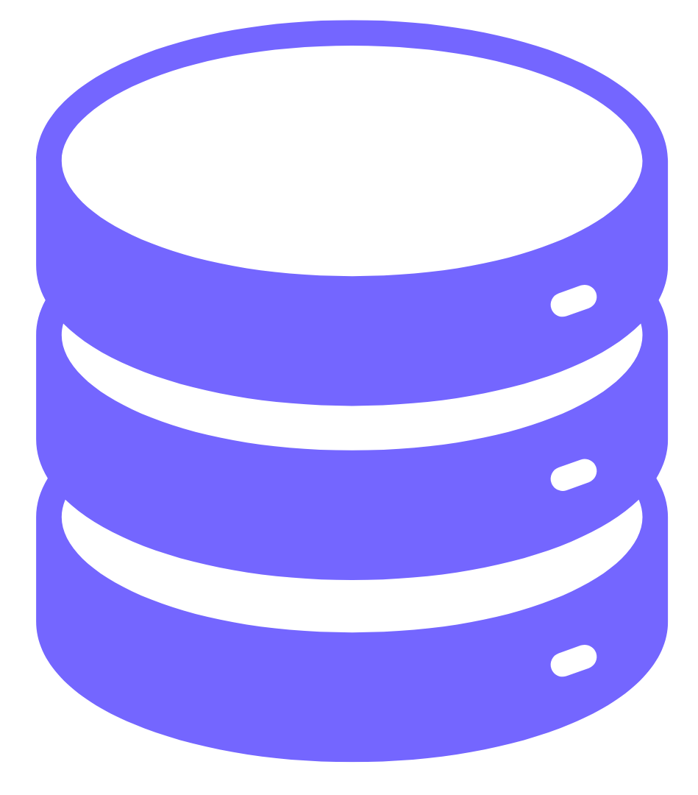
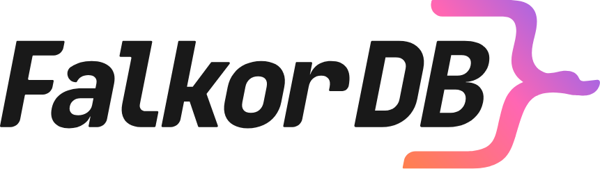
GraphRAG — LLM-ready architecture
Graph + vector retrieval — unified knowledge context
LLM
Cypher + Vector
→ Multi-hop expand → cosine rerank
Ontology
Knowledge Context
Ontology (Opt)
Accurate
response
Query
LLM

Slide 22
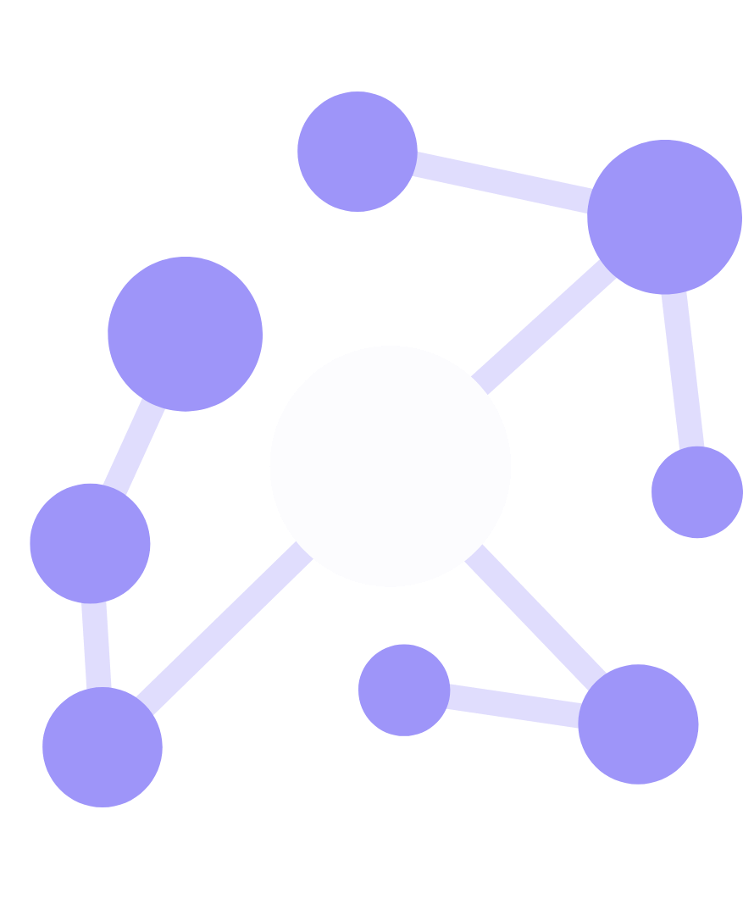
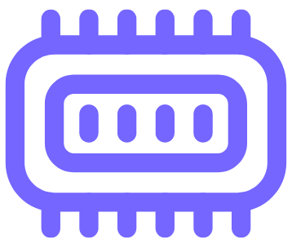
A critical component in Agentic solutions
Knowledge retrieval
Enterprise Knowledge Retrieval: extracting the relevant sub-knowledge
Knowledge Context
Query
Personalized Memory Retrieval: extracting the relevant long-term memory
Memory Context
Notes:
This is our GraphRAG architecture — and it's the reason we can deliver both precision and recall that pure RAG simply can't match.
Let me address the elephant in the room: you'll hear people say "RAG is dead." That's hype. What's actually dead is naive, 2023-style chunk-and-embed RAG. The global RAG market was $1.2 billion in 2024 and is projected to reach $2.76 billion this year. RAG isn't dying — it's evolving. And GraphRAG is where it's evolving to.
Here's how our architecture works. A user query enters the system and fans out to three parallel search paths.
Graph Search handles relationships — "Who reports to Alice?" or "What projects is this customer working on?" This is structural traversal using Cypher queries that follow edges in the knowledge graph.
Vector Search handles semantics — "Find memories similar to hiking in mountains." This uses embeddings stored alongside graph nodes to find contextually relevant information even when exact terms don't match.
Full-Text Search handles keywords — exact names, product codes, specific terms that need precise lookup rather than fuzzy semantic similarity.
These three streams merge into a unified Knowledge Context. This is the critical insight: you don't choose between graph, vector, or text search — you use all three together. The graph provides structure, vectors provide meaning, and full-text provides precision.
That unified context feeds into the LLM, which now has everything it needs to generate an accurate answer. No hallucination from missing context, no irrelevant results from keyword mismatch, no missed relationships from flat retrieval. As Guy Korland said at Nvidia GTC: "Without good, clean, and fast data, you get no good inference."

Slide 23
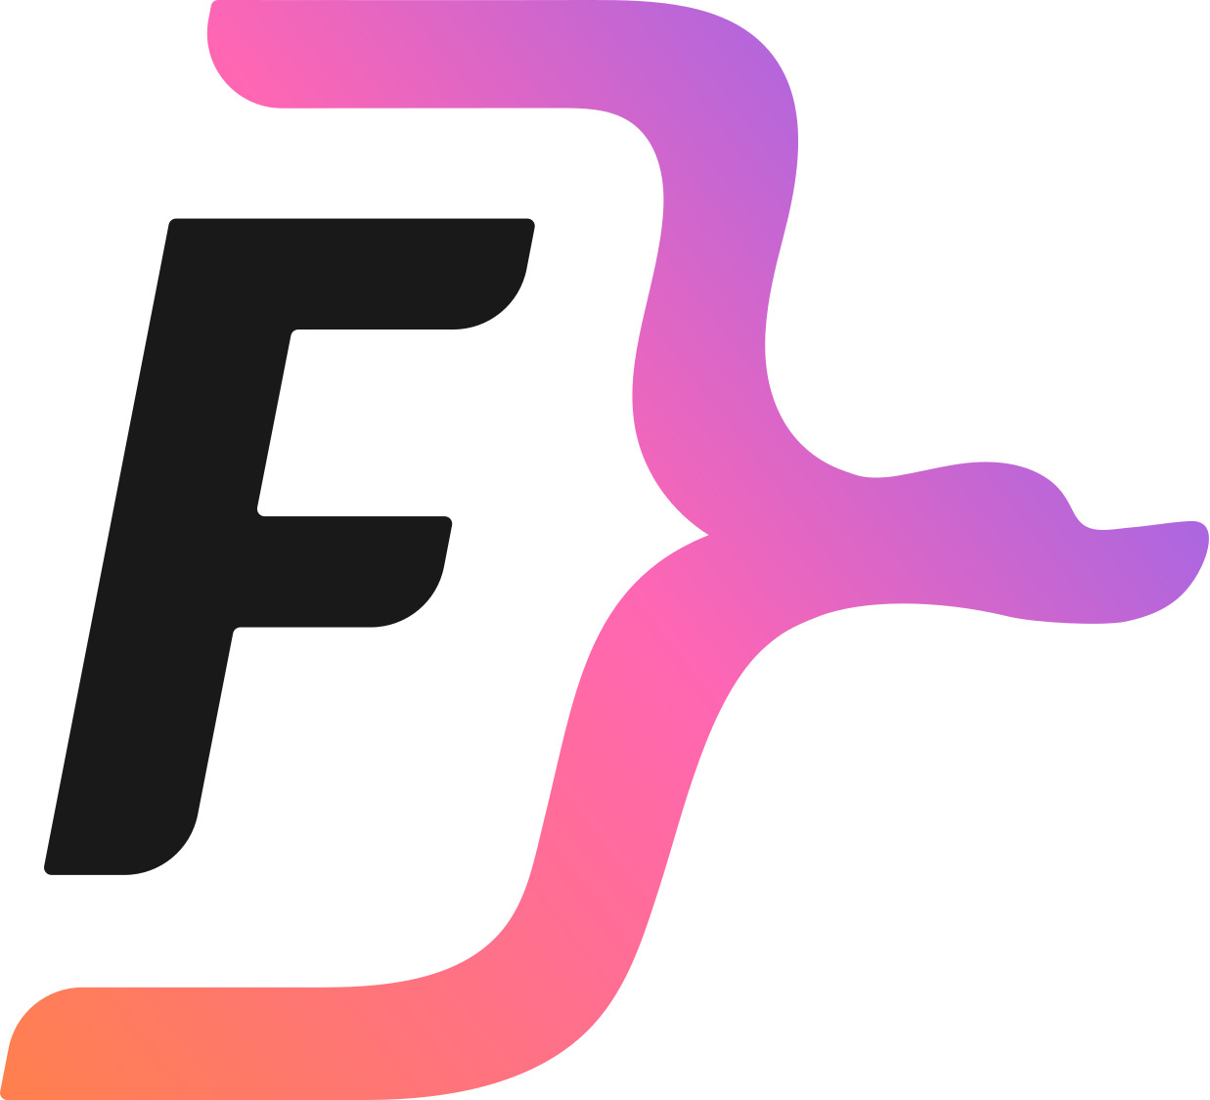
LLM-ready architecture
Answer Generation
Query
Knowledge Context
Accurate response with improved personalization and context-awareness
Memory Context
Notes:
This slide completes the pipeline. We've shown how knowledge and memory are retrieved separately — now here's how they come together.
FalkorDB provides the unified backend. The Query arrives, and FalkorDB delivers two context packages: the Knowledge Context from the enterprise graph, and the Memory Context from the user's personal graph.
These three inputs — the original query, the knowledge context, and the memory context — are combined into a single prompt and fed to the LLM. This is the "LLM-ready" part. We're not sending raw graph data or massive text dumps to the model. We're sending curated, relevant, structured context that the LLM can immediately reason with.
The result: an accurate response with improved personalization and context-awareness.
Accurate — because the knowledge graph grounds it in verified organizational facts, reducing hallucinations. Our tests showed accuracy jumping from 56% to over 90% with this architecture.
Personalized — because the memory graph provides individual user context. The agent remembers you.
Context-aware — because graph traversal captures multi-hop relationships that flat retrieval misses.
And fast — all of this happens in sub-140 milliseconds for the retrieval step. The user doesn't wait. The agent doesn't burn excessive tokens. The answer is better because the context is richer, more relevant, and more structured.
This is the full FalkorDB value proposition: from query, to graph, to LLM, to accurate personalized response. All in one integrated architecture.

