Slide 1

MySQL Binary Logs:
Your Database's Black Box Flight Recorder
Brijesh Patel · Percona Live 2026
Track: MySQL / Performance & Operations
"No more flying blind in production. Your binary logs have been trying to tell you something all along."

Slide 2
ABOUT
About Brijesh Patel
Brijesh Patel
What We're Solving Today
brijesh.patel@cwan.com
https://www.linkedin.com/in/bhpatel
Cache invalidation that breaks under heavy DB load
MySQL practitioner with 15+ years in
high-availability production systems
Microservices tightly coupled to the DB
Passionate about turning database
ETL windows delaying analytics by hours
internals into operational superpowers
Enfusion, a CWAN company, is a cloud-native software and analytics platform used by hedge funds, asset managers, and institutional investors to manage their entire investment lifecycle. It unifies front-, middle-, and back-office operations into a single platform, eliminating disconnected tools and manual reconciliation.
Determine what is triggering the replication lag
Production incidents with no audit trail
Percona Live 2026 · MySQL Binary Logs · brijesh.patel@cwan.com

Slide 3
THE PROBLEM
Flying Blind in Production
Most teams treat binary logs as a replication detail. They're missing 80% of the value.
Cache Stampede
Tight Coupling
Stale data in Redis/Ignite hours after the DB row changed. No reliable invalidation signal.
Microservices poll the DB or share schemas. One slow consumer blocks the primary.
Batch ETL
Invisible Lag
Analytics team runs nightly EXTRACT jobs. By morning the data is already 12 hours stale.
Replica is 45 seconds behind. You find out when a customer sees the wrong balance.
No Audit Trail
Incident Blindness
Something went wrong at 3am. SHOW PROCESSLIST shows nothing. The culprit is long gone.
A mass DELETE hit the wrong table. You have no before-image. Rollback is a restore.
Percona Live 2026 · MySQL Binary Logs · brijesh.patel@cwan.com

Slide 4
FOUNDATIONS
Binary Logs 101 — What They Actually Are
Write-Ahead Log (WAL)
THE BINLOG PIPELINE
Records every committed transaction — in order, durably, before ACK to client.
MySQL Primary
Available Formats
↓
binlog.000001..N
ROW captures full before/after images. STATEMENT logs the SQL. MIXED chooses per-statement.
↓
GTID Support (5.6+)
Binlog Reader
(mysqlbinlog / lib)
Global Transaction IDs give every transaction a unique, server-independent identifier.
↓
Retention Control
Your Application
expire_logs_days or binlog_expire_logs_seconds. Default in 8.0: 30 days.
Percona Live 2026 · MySQL Binary Logs · brijesh.patel@cwan.com

Slide 5
FOUNDATIONS
ROW vs STATEMENT vs MIXED
For CDC and event-driven use cases, always use ROW format.
STATEMENT
ROW
MIXED
Pros
Pros
Pros
Compact logs — low disk use
Full before & after image for every row
Uses STATEMENT where safe
Human-readable SQL output
Deterministic — safe for all statements
Falls back to ROW for unsafe queries
Powers CDC, cache invalidation, analytics
Cons
Cons
Non-deterministic functions break replication (UUID, NOW)
Cons
Still no before-image from STATEMENT events
No before-image — cannot reverse a change
Larger log files (mitigate with binlog_row_image=MINIMAL)
Unpredictable log size
Unsafe for CDC
Bulk UPDATEs produce many events
CDC must handle both event types
Legacy mode. Avoid for new setups.
Recommended for all modern use cases.
Transitional compromise — prefer ROW.
SET GLOBAL binlog_format='ROW'; SET GLOBAL binlog_row_image='FULL'; SET GLOBAL gtid_mode='ON';
Percona Live 2026 · MySQL Binary Logs · brijesh.patel@cwan.com

Slide 6
FOUNDATIONS
GTID Architecture
Global Transaction Identifiers — the key to reliable position tracking
GTID FORMAT:
3E11FA47-71CA-11E1-9E33-C80AA9429562
:
1000
← Server UUID
← Transaction #
Globally Unique
Immutable
UUID + sequence → no two transactions ever share the same GTID across any server in the topology.
A GTID assigned on the primary travels unchanged through every replica hop. Never re-generated.
Gap Detection
Safe Failover
GTID_EXECUTED set lets you instantly see which transactions a replica has — and hasn't — applied.
New primary auto-starts from the correct position. No more manual log file + position hunting.
Percona Live 2026 · MySQL Binary Logs · brijesh.patel@cwan.com

Slide 7
AGENDA
5 Use Cases — Beyond Replication
01
CDC + Cache Invalidation
Blackhole engine trick + real-time eviction
02
Binlog as Event Bus
Microservices decoupling with zero app changes
03
Real-time Analytics Pipeline
Stream row changes → OLAP in under 2 seconds
04
GTID Timestamp Anomaly Detection
original_commit_ts vs immediate_commit_ts
05
Forensics & Incident Response
Surgical replay, root-cause, rollback
Percona Live 2026 · MySQL Binary Logs · brijesh.patel@cwan.com

Slide 8
USE CASE 1
CDC + Cache Invalidation
Change Data Capture without touching application code
MySQL
Primary
BLACKHOLE
Engine Table
Binlog
Reader
Redis /
Memcached
→
→
→
Stores NOTHING.
Logs everything to binlog.
WHY THIS WORKS
-- 1. Shadow Blackhole table
CREATE TABLE shadow_products LIKE products
ENGINE = BLACKHOLE;
-- 2. Trigger on real table → shadow
CREATE TRIGGER after_product_update
AFTER UPDATE ON products FOR EACH ROW
INSERT INTO shadow_products VALUES (NEW.id, NEW.price, NOW());
-- 3. Reader sees binlog event → evicts cache key
Zero app-code changes
Sub-100ms cache eviction
Works across microservices
No extra DB load
Percona Live 2026 · MySQL Binary Logs · brijesh.patel@cwan.com

Slide 9
USE CASE 1
The Blackhole Engine
Accepts writes, discards data, but still logs every event to the binlog.
What It Does
Why That Matters
Common Pattern
Accepts any INSERT/UPDATE/DELETE
Creates a pure change event stream
Run Blackhole on a dedicated replica
Writes the event to the binary log
Binlog readers see the event as-is
Point Debezium / Maxwell at it
Stores absolutely nothing on disk
Full ROW format: before + after
Primary is not burdened by readers
Returns success immediately
Zero storage overhead
Blackhole replica has minimal lag risk
Uses negligible disk/memory
Can sit on a dedicated replica
Clean separation of concerns
SHOW ENGINES; -- | BLACKHOLE | YES | /dev/null CREATE TABLE shadow LIKE source ENGINE=BLACKHOLE;
Percona Live 2026 · MySQL Binary Logs · brijesh.patel@cwan.com

Slide 10
CODE
Cache Invalidation in Practice
from pymysqlreplication import BinLogStreamReader
from pymysqlreplication.row_event import WriteRowsEvent, UpdateRowsEvent
import redis
r = redis.Redis(host="localhost", port=6379)
stream = BinLogStreamReader(
connection_settings={"host":"127.0.0.1","port":3306,
"user":"replicator","passwd":"secret"},
server_id=100, only_tables=["shadow_products"],
only_events=[WriteRowsEvent, UpdateRowsEvent],
blocking=True, resume_stream=True)
for event in stream:
for row in event.rows:
vals = row.get("values") or row.get("after_values")
keys = [f"product:{vals['id']}",
f"category:{vals['category_id']}:listing"]
r.delete(*keys)
Tip: run as a sidecar per service — each service owns its own cache eviction logic.
Percona Live 2026 · MySQL Binary Logs · brijesh.patel@cwan.com

Slide 11
USE CASE 2
Binlog-as-Event-Bus for Microservices
Turn every committed row change into a domain event — no code changes to the producer
MySQL + Binlog
↓
Debezium / Maxwell
↓
Kafka db.orders.changes
↙ ↓ ↓ ↘
Email
Service
Inventory
Service
Analytics
Service
Audit
Service
No polling. No API coupling. Guaranteed ordering. At-least-once delivery.
Decouple producers from consumers · Schema changes are isolated · Replay from any point in time · Add consumers without touching the DB
Percona Live 2026 · MySQL Binary Logs · brijesh.patel@cwan.com

Slide 12
USE CASE 2
Choosing Your Binlog Reader
Debezium, Maxwell's Daemon, or Canal — pick the right tool
Debezium
Maxwell's Daemon
Canal (Alibaba)
Java / Kafka Connect
Java — outputs JSON to Kafka/SQS/HTTP
Java — Alibaba open-source
Pros
Pros
Pros
Full Kafka Connect ecosystem
Simpler setup than Debezium
Battle-tested at Alibaba scale
Schema registry support
HTTP output — no Kafka needed
Low resource footprint
Multi-DB: MySQL, Postgres, MongoDB
Row filtering & column masking built-in
Flexible adapter model
Enterprise-grade, large community
Good for medium-scale setups
Active Chinese community
Cons
Cons
Cons
Requires Kafka infrastructure
MySQL-only
Chinese-first documentation
JVM overhead
Less active maintenance
Less Western community support
Complex config for simple use cases
No schema registry
Custom protocol adapter required
Percona Live 2026 · MySQL Binary Logs · brijesh.patel@cwan.com

Slide 13
CODE
Binlog Reader in Python (mysql-replication)
Key Config
from pymysqlreplication import BinLogStreamReader
from pymysqlreplication.row_event import (
WriteRowsEvent, UpdateRowsEvent, DeleteRowsEvent)
stream = BinLogStreamReader(
connection_settings={
"host": "127.0.0.1", "port": 3306,
"user": "replicator", "passwd": "secret"},
server_id=100,
only_events=[WriteRowsEvent, UpdateRowsEvent, DeleteRowsEvent],
log_file="binlog.000042",
resume_stream=True, blocking=True)
for binlogevent in stream:
for row in binlogevent.rows:
event = {
"table": binlogevent.table,
"type": type(binlogevent).__name__,
"values": row.get("values") or row.get("after_values")}
publish_to_kafka("db.changes", event)
stream.close()
server_id
Unique — cannot clash with any replica
only_events
Filter to row-change events only
log_file
Resume from saved checkpoint
blocking=True
Long-poll — no busy-wait loop
resume_stream
Survive restart gracefully
Percona Live 2026 · MySQL Binary Logs · brijesh.patel@cwan.com

Slide 14
USE CASE 3
Real-time Analytics Pipeline
From OLTP to OLAP in milliseconds — no ETL window
MySQL
OLTP
Debezium
(Kafka Connect)
Apache
Kafka
Flink /
Spark
ClickHouse
/ BigQuery
Grafana
/ Superset
→
→
→
→
→
Typical end-to-end latency: 200ms – 2s · No batch windows · No replica read lag for analytics
-- Debezium connector config
{
"connector.class": "io.debezium.connector.mysql.MySqlConnector",
"database.hostname": "mysql-primary",
"database.server.name": "prod",
"table.include.list": "orders.line_items",
"transforms": "unwrap",
"transforms.unwrap.type":
"io.debezium.transforms.ExtractNewRecordState",
"snapshot.mode": "initial"
}
Percona Live 2026 · MySQL Binary Logs · brijesh.patel@cwan.com

Slide 15
USE CASE 4
GTID Timestamp Analysis
Most DBAs have never read these two hidden fields. They hold your early-warning system.
← LAG (microseconds) →
Transaction
commits on PRIMARY
Relay log
applied on REPLICA
original_commit_timestamp
immediate_commit_timestamp
original_commit_timestamp
Set on the PRIMARY when the transaction commits. Immutable — never changes as the event propagates. UTC microseconds since epoch.
immediate_commit_timestamp
Set on the SERVER that wrote this event to its binlog — primary first, then each replica on relay-log apply. Changes at every hop.
LAG = immediate_commit_timestamp − original_commit_timestamp
Percona Live 2026 · MySQL Binary Logs · brijesh.patel@cwan.com

Slide 16
DEEP DIVE
Two Timestamps, One Story
original_commit_timestamp
immediate_commit_timestamp
When the transaction was COMMITTED on the ORIGINAL primary. Set once. Never changes. This is your source of truth.
When this specific server committed or applied the transaction. Changes at each hop. Reflects replication lag.
Available in:
Available in:
Performance Schema · mysqlbinlog
GTID_EXECUTED · Replication tables
Performance Schema · mysqlbinlog
GTID_EXECUTED · Replication tables
-- View GTID timestamps directly (MySQL 8.0+)
SELECT ORIGINAL_COMMIT_TIMESTAMP, IMMEDIATE_COMMIT_TIMESTAMP,
(IMMEDIATE_COMMIT_TIMESTAMP - ORIGINAL_COMMIT_TIMESTAMP)/1e6 AS lag_s
FROM performance_schema.replication_applier_status_by_worker;
Percona Live 2026 · MySQL Binary Logs · brijesh.patel@cwan.com

Slide 17
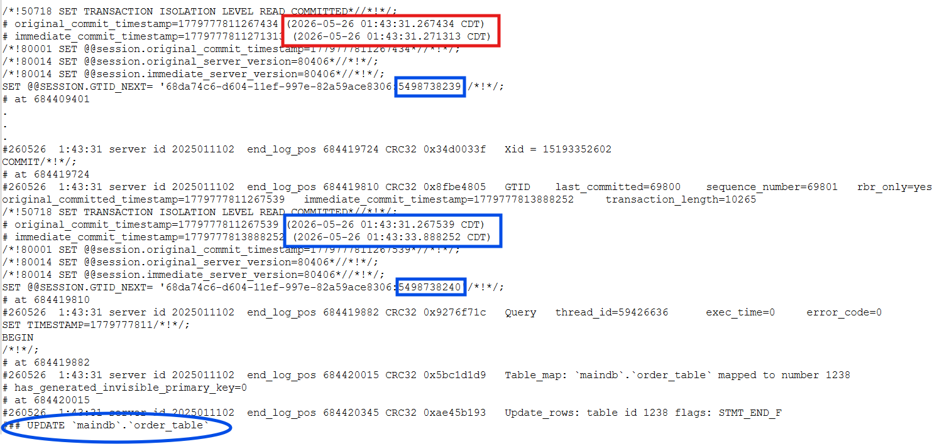

DEEP DIVE
Detecting Replication lag culprit in MySQL binlogs
Percona Live 2026 · MySQL Binary Logs · brijesh.patel@cwan.com

Slide 18
DEEP DIVE
Measuring Database Replication Latency as it Happens
-- Replication lag with microsecond precision
SELECT
ORIGINAL_COMMIT_TIMESTAMP,
IMMEDIATE_COMMIT_TIMESTAMP,
(IMMEDIATE_COMMIT_TIMESTAMP
- ORIGINAL_COMMIT_TIMESTAMP) / 1e6 AS lag_seconds,
CASE
WHEN (IMMEDIATE_COMMIT_TIMESTAMP
- ORIGINAL_COMMIT_TIMESTAMP) > 5000000
THEN 'CRITICAL LAG'
WHEN (IMMEDIATE_COMMIT_TIMESTAMP
- ORIGINAL_COMMIT_TIMESTAMP) < 0
THEN 'CLOCK SKEW'
ELSE 'OK'
END AS status
FROM performance_schema.replication_applier_status_by_worker;
Anomaly Patterns to Alert On:
⚠ Replication Lag Spike — lag_seconds > threshold
⚠ Clock Skew — lag_seconds < 0
⚠ Replica Stall — lag growing monotonically
⚠ Partial Apply — GTID gaps in executed set
Percona Live 2026 · MySQL Binary Logs · brijesh.patel@cwan.com

Slide 19
MONITORING
Prometheus Alerting Rules
Codify your GTID lag thresholds — alert before your users feel the pain
# prometheus/rules/mysql_replication.yml
groups:
- name: mysql_replication
rules:
- alert: ReplicationLagHigh
expr: mysql_gtid_lag_seconds > 5
for: 1m
labels: { severity: critical }
annotations:
summary: "{{ $labels.instance }}: {{ $value }}s lag"
- alert: ReplicaStalled
expr: increase(mysql_gtid_lag_seconds[5m]) > 0
for: 2m
labels: { severity: page }
- alert: ClockSkew
expr: gtid_immediate_ts - gtid_original_ts < 0
labels: { severity: warning }
Export metrics via: mysqld_exporter · pt-heartbeat · Custom Python exporter reading performance_schema
Percona Live 2026 · MySQL Binary Logs · brijesh.patel@cwan.com

Slide 20
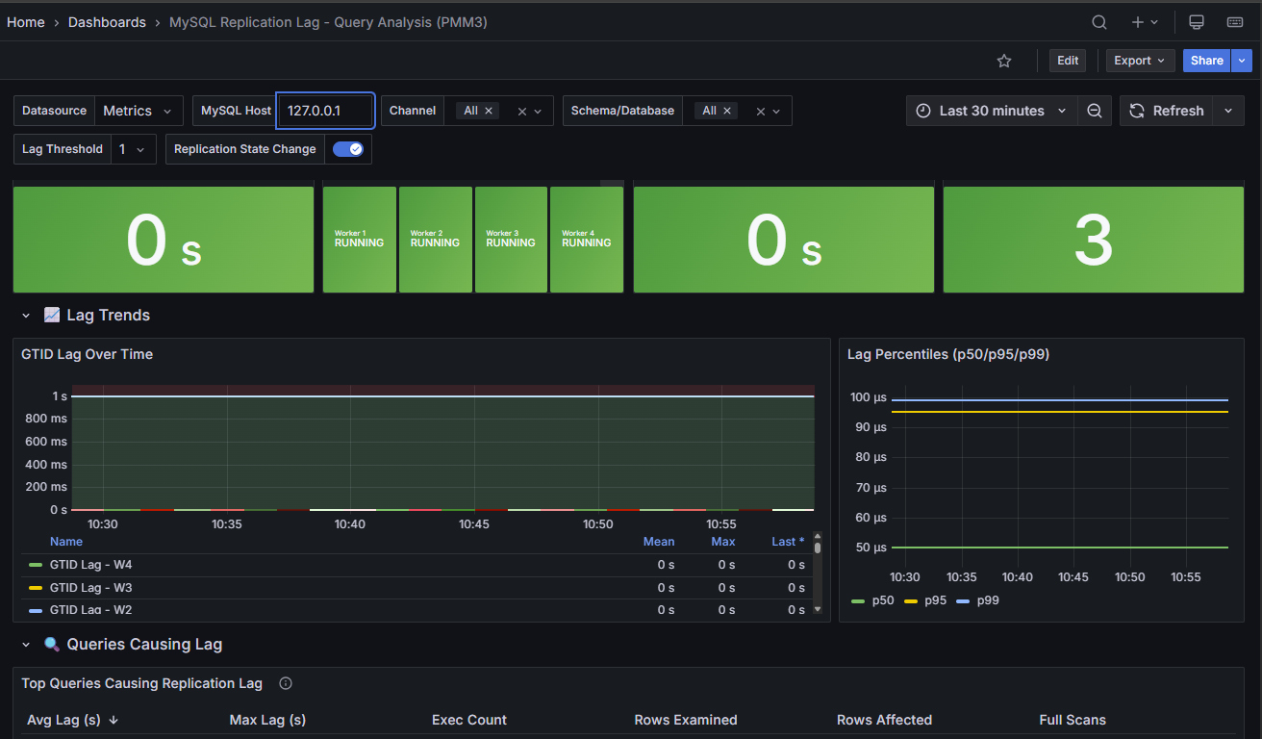
MONITORING
Custom PMM Dashboard
Codify your GTID lag thresholds — alert before your users feel the pain
# prometheus/rules/mysql_replication.yml
groups:
- name: mysql_replication
rules:
- alert: ReplicationLagHigh
expr: mysql_gtid_lag_seconds > 5
for: 1m
labels: { severity: critical }
annotations:
summary: "{{ $labels.instance }}: {{ $value }}s lag"
- alert: ReplicaStalled
expr: increase(mysql_gtid_lag_seconds[5m]) > 0
for: 2m
labels: { severity: page }
- alert: ClockSkew
expr: gtid_immediate_ts - gtid_original_ts < 0
labels: { severity: warning }
Percona Live 2026 · MySQL Binary Logs · brijesh.patel@cwan.com

Slide 21
MONITORING
Open-Source Monitoring Stack
Real-time GTID lag visualization — ship it to PMM on day one
1. Performance Schema Exporter
Scrapes GTID lag, worker status, applier events from MySQL
2. Prometheus
Time-series storage + threshold alerts + long-term retention
3. Grafana
Lag heatmap, spike timeline, multi-replica topology view
4. Alertmanager
Routes CRITICAL → PagerDuty, WARNING → Slack, with inhibition rules
Full Grafana dashboard JSON included in session materials — import in 60 seconds
Percona Live 2026 · MySQL Binary Logs · brijesh.patel@cwan.com

Slide 22
USE CASE 5
Forensics & Incident Response
Surgical replay — find exactly what changed and when
1
Identify Time Window
2
Extract Row Changes
GTID timestamps bracket the incident.
mysqlbinlog --start-datetime=... --stop-datetime=...
--base64-output=DECODE-ROWS -vv
Reveals before/after values for every row.
3
Filter by Table/Query
4
Surgical Rollback
grep -A5 'table_id.*orders' binlog.000099
Or pipe through pt-query-digest.
Replay filtered events on a clone.
Apply inverse operations to restore.
Percona Live 2026 · MySQL Binary Logs · brijesh.patel@cwan.com

Slide 23
CASE STUDY
Real Incident: The 3am Mass Delete
"Something deleted 40,000 orders. We have no idea what."
03:14
PagerDuty alert: order count anomaly
03:17
SHOW PROCESSLIST — nothing running. No active sessions.
03:19
Check slow query log — empty. No DELETE recorded.
03:22
mysqlbinlog --start-datetime='03:10' --stop-datetime='03:16' binlog.000142
03:24
Found: 40,312 DELETE events from connection_id=8821 in 90 seconds
03:26
Traced connection to a batch job with a missing WHERE clause
03:31
Replayed binlog events inverted on clone → restored deleted rows
03:45
Full recovery. RTO: 31 minutes. Without binlog: days.
Percona Live 2026 · MySQL Binary Logs · brijesh.patel@cwan.com

Slide 24
REFERENCE
mysqlbinlog Cheat Sheet
# Decode row events with before/after values
mysqlbinlog --base64-output=DECODE-ROWS -vv binlog.000042
# Filter by time window
mysqlbinlog --start-datetime="2026-05-20 14:00:00" \
--stop-datetime="2026-05-20 14:05:00" binlog.000042
# Stream live from running server
mysqlbinlog --read-from-remote-server \
--host=prod-mysql --user=replicator \
--password=*** --stop-never binlog.000042
# Show GTID timestamps (MySQL 8.0+)
mysqlbinlog --print-table-metadata -v binlog.000042 \
| grep -E "GTID|original|immediate"
Always use --base64-output=DECODE-ROWS with ROW format binlogs
Pipe to mysql client to replay events selectively on a clone
Percona Live 2026 · MySQL Binary Logs · brijesh.patel@cwan.com

Slide 25
REFERENCE
Point-in-Time Recovery (PITR)
Restore to any second — not just your last backup
1
Restore base backup
2
Find the incident GTID
xtrabackup --copy-back --datadir=/var/lib/mysql-recovery
Start MySQL on recovery server
mysqlbinlog -vv binlog.000142 | grep -B5 'DELETE.*orders'
Note the GTID: abc123-...:9041
3
Replay binlogs up to incident
4
Validate and promote
mysqlbinlog --stop-position=<pos_before_incident> \
binlog.000140 binlog.000141 binlog.000142 | mysql -h recovery
Compare row counts. Validate checksums.
promote recovery instance or export affected tables
Percona Live 2026 · MySQL Binary Logs · brijesh.patel@cwan.com

Slide 26
REFERENCE
Production Binlog Config Checklist
my.cnf settings every production MySQL replica should have
[mysqld]
# ── Binlog enable ────────────────────────────────
log_bin = /var/log/mysql/binlog
binlog_format = ROW
binlog_row_image = FULL # full before+after images
sync_binlog = 1 # flush to disk on every commit
# ── GTID ─────────────────────────────────────────
gtid_mode = ON
enforce_gtid_consistency = ON
# ── Retention ────────────────────────────────────
binlog_expire_logs_seconds = 604800 # 7 days
max_binlog_size = 512M
# ── Replication safety ───────────────────────────
replica_preserve_commit_order = ON # 8.0+ parallelism safety
binlog_transaction_dependency_tracking = WRITESET
sync_binlog=1 · binlog_row_image=FULL · gtid_mode=ON — the three settings that unlock everything in this talk
Percona Live 2026 · MySQL Binary Logs · brijesh.patel@cwan.com

Slide 27
TAKEAWAYS
What You're Taking Home Today
01
CDC Without App Changes
Blackhole + binlog reader = cache invalidation & data sync with zero application coupling.
02
Event Bus for Free
Debezium turns binlog into Kafka topics. Every downstream service gets domain events.
03
Real-time Analytics
Ditch nightly ETL. Stream row changes into your OLAP engine in under 2 seconds (when there is no lag).
04
Detect Lag Before It Hurts
original_commit_ts − immediate_commit_ts = early-warning system for replication disasters.
05
Full Forensic Trail
Every row change is auditable. PITR to the second. You already have a flight recorder — use it.
Percona Live 2026 · MySQL Binary Logs · brijesh.patel@cwan.com

Slide 28
RESOURCES
Open Source Tools & Further Reading
Binlog Readers
CDC Connectors
mysql-replication (Python)
Debezium (Kafka Connect)
Maxwell's Daemon
Canal (Alibaba)
go-mysql-replication
SpinalTap (Airbnb)
Monitoring
Forensics
mysqld_exporter + Prometheus
mysqlbinlog (built-in)
Grafana GTID lag dashboard
pt-query-digest
pt-heartbeat
binlog2sql
Percona Live 2026 · MySQL Binary Logs · brijesh.patel@cwan.com

Slide 29
Thank You
brijesh.patel@cwan.com
https://www.linkedin.com/in/bhpatel
Questions? Let's debug production together.
Percona Live 2026 · Track: MySQL / Performance & Operations · Slides + code at github.com/brijeshatcwan

