Slide 1

FROM
ATLAS
TO EKS
How to stay sane and save 45% during a large‑scale MongoDB migration
Yurii Olshanetskyi
Principal Data Engineer

Slide 2
AGENDA
Why leave a fully‑managed Cloud Database?
Choosing the platform: From theory to reality
Large‑Scale Migration: The Pain Points Nobody Warns Us About
After the Cutover: Life Without Atlas
Questions

Slide 3
THE BUSINESS CASE FOR CHANGE
 | Atlas (Managed) | Self-Managed EKS
Monthly Cost | $100,000 | $70,000 (initial goal)
Control Level | Limited customization | Full control
Monitoring | Vendor-provided | Integrated to existing monitoring/alerting infrastructure
Strategic Fit | Standalone service | Aligned with EKS strategy

Slide 4
ATLAS OR SELF-MANAGED:
WHAT TO CHOOSE
When Atlas
makes sense:
When Self-managed
makes sense:
Early-stage businesses (start-ups)
Don't have specialists to maintain infrastructural overhead
Need to focus on product, not infrastructure
Mature engineering resources available
No strings attached to specific platform features
Cost optimization at scale
Operational control required

Slide 5


PLATFORM OPTIONS EVALUATED
Self-Managed
on EC2
Self-Managed
K8s + Operator
Other
Managed
Scaling
Healing
Configuration
Optimization
❌
Cost
Lowest
Low
Highest

Slide 6
PLATFORM OPTIONS EVALUATED
MongoDB
Community edition
MongoDB
Enterprise
Percona Server
For MongoDB
Security
❌
Maintainability
Cost
Free
High
Free

Slide 7
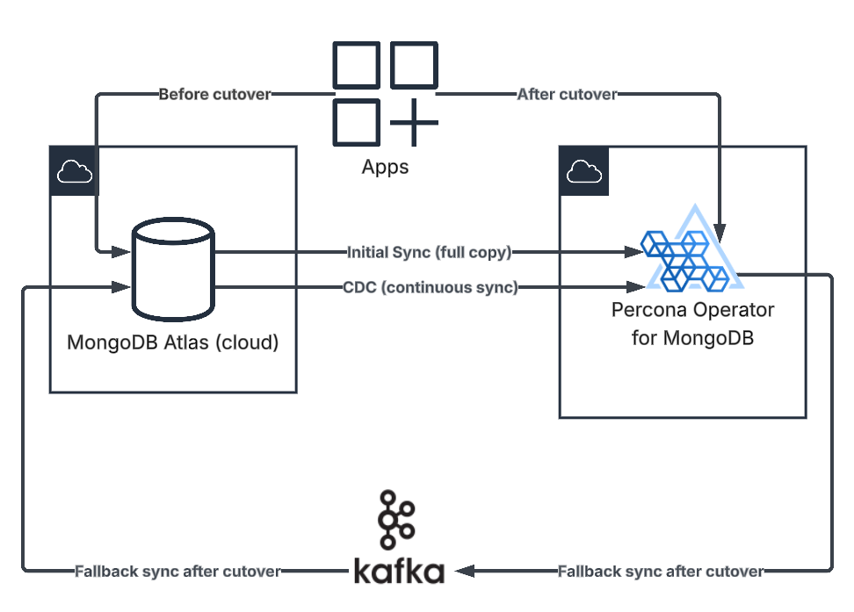
MIGRATION ARCHITECTURE OVERVIEW
Core Principles & Foundation​
1
Minimal Disruption
Target: 2-5 hour maintenance window
2
Reduce Blast Radius
Incremental cluster cutover (one by one)
3
Solid Rollback Strategy
Tested and ready under pressure
4
Tools:
GitOps foundation (ArgoCD)
MongoSync for data migration
Kafka CDC for roll-back

Slide 8
PRODUCTION MIGRATION:
WHEN REALITY HIT HARD
Oplog window is too short to sync data
MongoSync continuously fails on data copy
CDC can’t handle the write traffic in real-time
No MongoDB support available

Slide 9
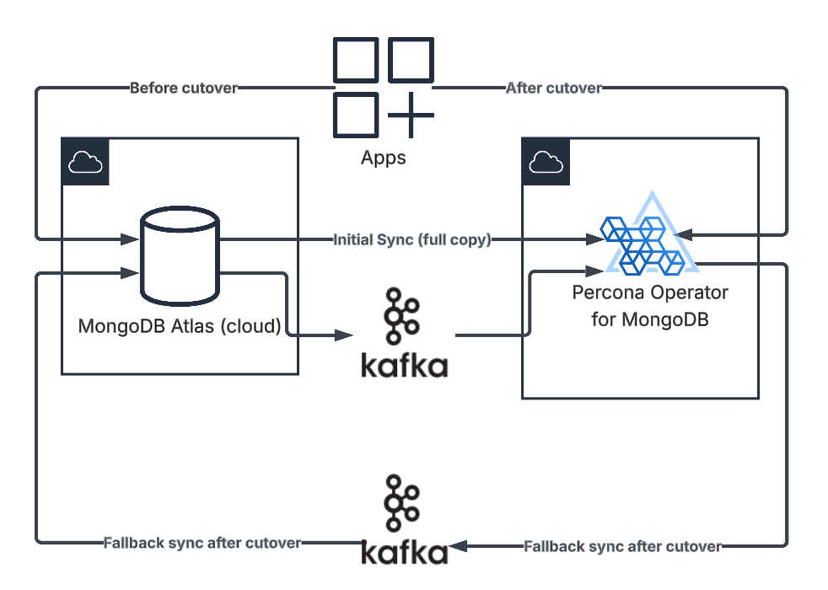
WHAT ACTUALLY WORKED IN PRODUCTION
Hybrid MongoSync + Kafka approach for data copy
Adjusted MongoDB Oplog operations to catch fullDocument
Cleanup legacy data

Slide 10
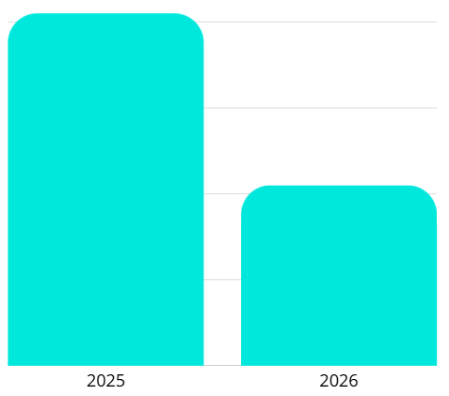
AFTER THE CUTOVER: LIFE WITHOUT ATLAS
Atlas shutdown finished on
Dec 15. 2025
Monthly cost decreased by 45%
Monitoring, backups, upgrades - now fully on us​
Solid foundation was built, but now there is technical debt to address
NOW IT IS ALL YOURS!
INCLUDING BENEFITS AND RESPONSIBILITY

Slide 11
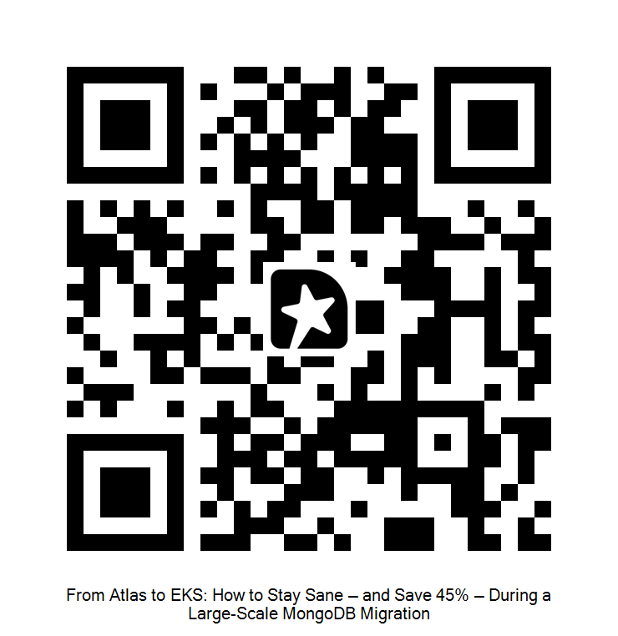


THANK YOU!
www.linkedin.com/in/yurii-olshanetskyi

